Slide 1


From Nuclei to Stars - A Case in Point:
Photoneutron Reaction Cross Section Measurements on ⁹⁴Mo and ⁹⁰Zr
Relevant to the p-Process Nucleosynthesis
Adriana Banu, E. G. Meekins
Department of Physics and Astronomy, James Madison University, USA
S. A. Silano, H. J. Karwowski
Triangle Universities Nuclear Laboratory (TUNL), University of North Carolina at Chapel Hill, USA
S. Goriely
Institut d’Astronomie et d’Astrophysique (IAA), Université Libre de Bruxelles, Belgique
Xth Edition of the Tastes of Nuclear Physics
Nov. 30 – Dec. 4, 2020
University of the Western Cape, South Africa
#TNP2020 @ ZOOM

Slide 2
to stars…
From nuclei…
Nuclear Physics is basic to two major themes in astrophysics:
the (nucleo)synthesis of the chemical elements
the energy generation in stars and stellar environments

Slide 3
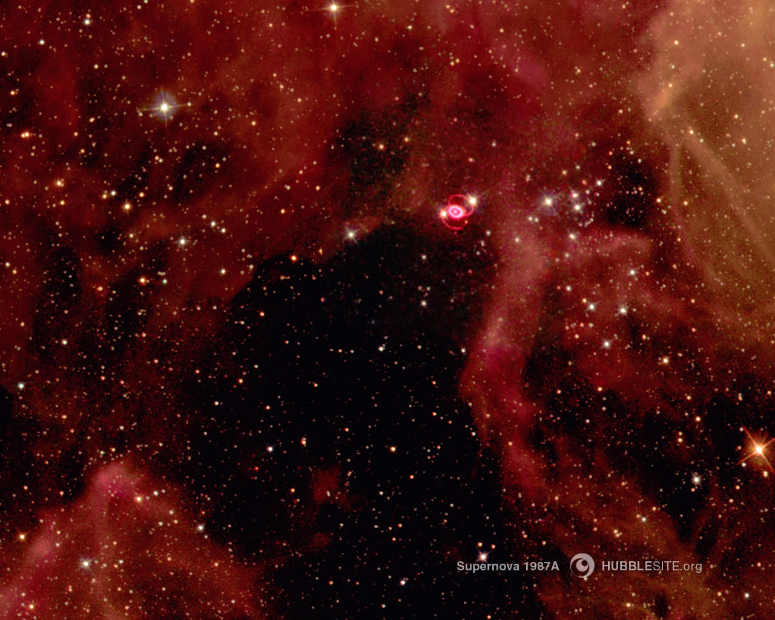
THE Big questions
Where Do The Chemical Building Blocks Of
Humankind Come From?
What Makes The Stars Shine?

Slide 4
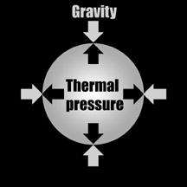
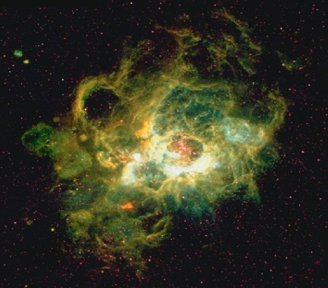
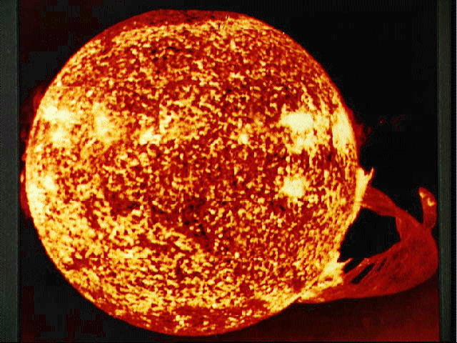
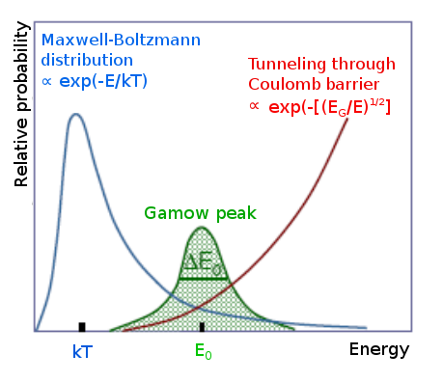
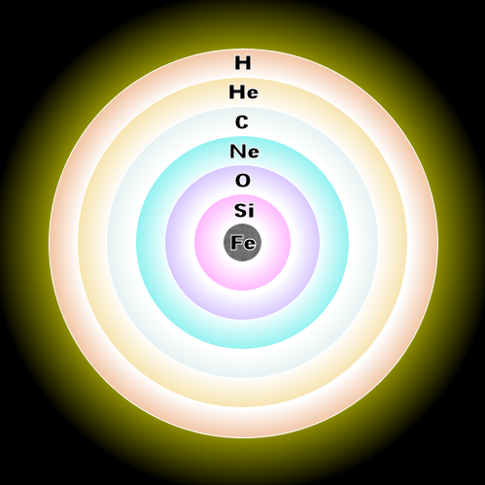
Stellar life cycle: Nucleosynthesis up to Iron
BIRTH
gravitational contraction
Interstellar gas
Stars
+
metals
element
mixing
DEATH
explosion
thermonuclear
reactions
⇔
energy production
stability against collapse
synthesis of “metals”

Slide 5
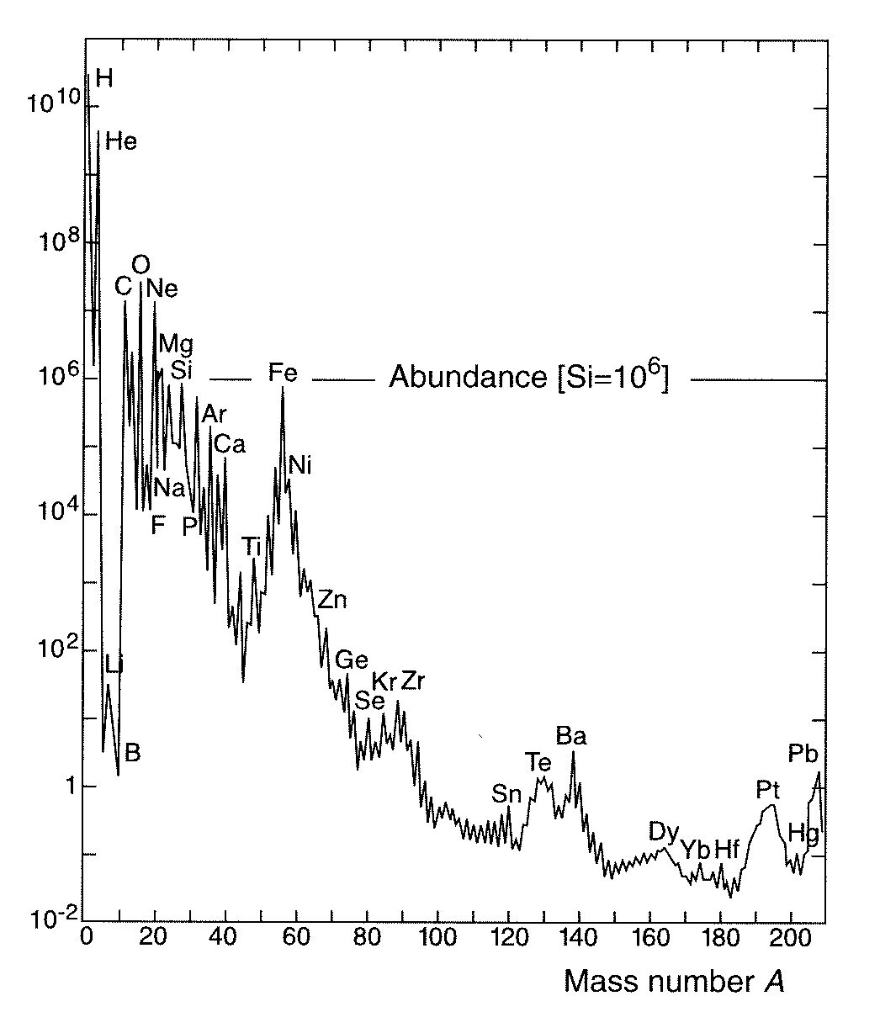
Abundance of the Elements
Almost 5 billion years ago, our solar system began the journey
with its gravitation collapse…
If we look around us today, we can see what elements
were in our interstellar cloud…

Slide 6
Solar Abundance of the Elements
Formed in Stars (Fusion)
Data sources:
Earth, Moon, meteorites,
stellar (Sun) spectra, cosmic rays...
Fe
Features:
12 orders-of-magnitude span
H ~ 75%
He ~ 23%
C → U ~ 2% (“metals”)
Au
The abundances of elements and isotopes are UNIQUE finger prints of various astrophysical processes.
To interpret and understand them, diverse and vast nuclear physics knowledge is needed!!!

Slide 7
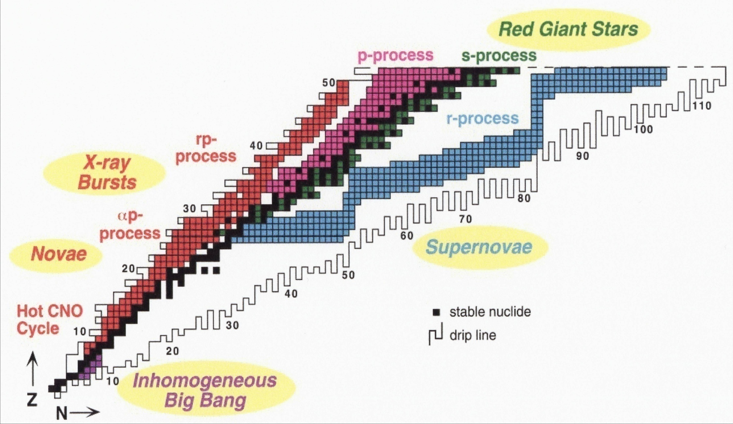
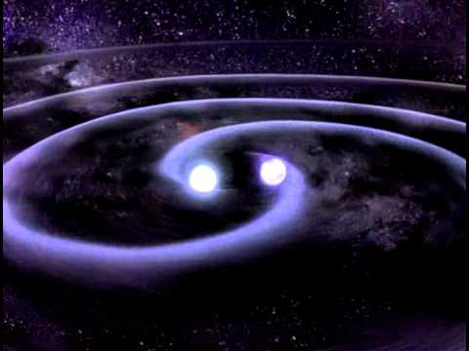
Overview of main astrophysical processes
neutron star mergers
M.S. Smith and K.E. Rehm, Ann. Rev. Nucl. Part. Sci, 51 (2001) 91-130

Slide 8

The p-process nucleosynthesis is responsible for the 35 proton-rich elements
heavier than iron in the Universe!
⁷⁴Se
¹⁹⁶Hg

Slide 9
Elemental Abundances and the Study of p-Nuclei
^{In the solar system,} ^{p-process contributes about} 1% to the elemental abundances!!!
s/r seed nuclei
M. Arnould & S. Goriely, Phys. Rep. 384, 1 (2003)
B²FH, Rev. Mod. Phys. 29, 547 (1957)
Notes:
Give input to modelers to reproduce this abundance

Slide 10
p-Process Nucleosynthesis:
an extended network of some 20000 reactions
linking about 2000 nuclei in the A ≤ 210 mass range
entrance channel
compound
nucleus
exit channel
Image from C. Iliadis, Nuclear Physics of Stars (2007)
^{Gamma-ray strength function}
^{Nuclear level density}
Nucleon-nucleus optical potential
Laboratory measurements are essential to improving the accuracy of stellar reaction rate theoretical predictions within Hauser-Feshbach statistical models:

Slide 11
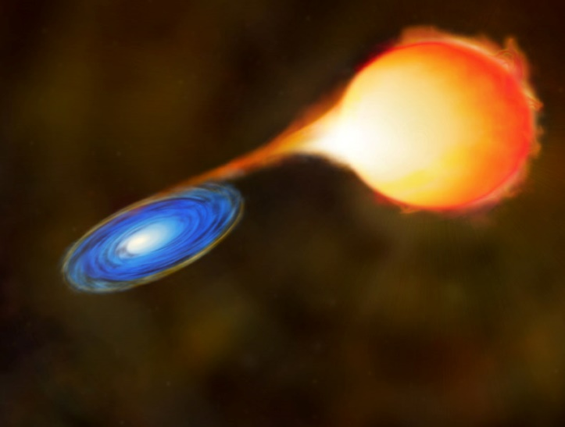
Why study
⁹⁴Mo(γ,n)⁹³Mo &
⁹⁰Zr(γ,n)⁸⁹Zr?
Type Ia SN
(artist view)
C. Travaglio et al., ApJ 739, 93 (2011)
⁹⁴Mo
strong production of s-process seeds
assumed !!
Full range of the p-nuclei produced with
similar enhancement factors relative to solar abundances
(only!) ⁹⁴Mo underproduced
⁹⁰Zr (thought as genuine s-process nucleus) was produced!

Slide 12
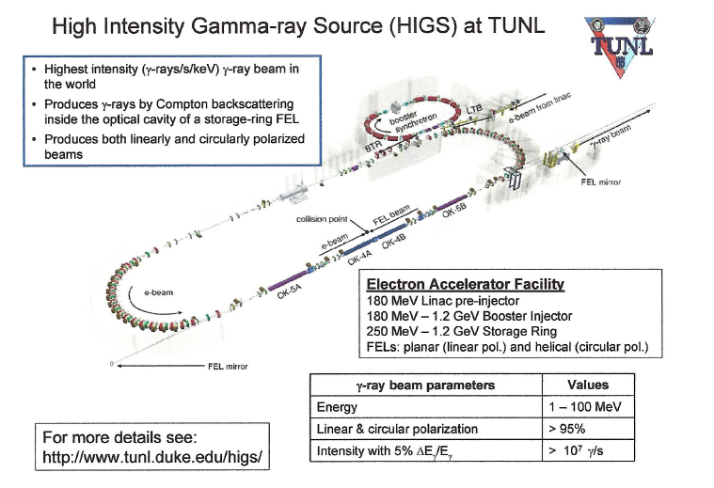

Slide 13
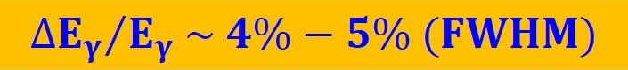
  ⁹⁴Mo: ~ 600 mg/cm² , 98.97%
  ⁹⁰Zr: ~ 1 g/cm², 97.7%
~ 10⁷ – 10⁸ γ/s

Slide 14
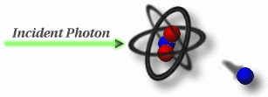
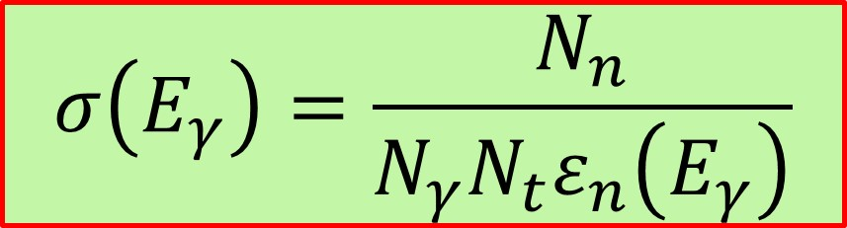
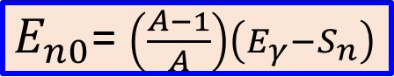
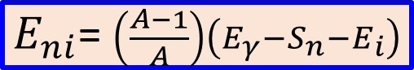
N_{n} – number of neutrons detected using ³He
counters
N_{γ} - number of incident photons
N_{t} – number of target atoms per unit area
(enriched target)
ε_{n} – neutron detection efficiency
~55% @ 20 keV - ~25% @ 4 MeV

Slide 15
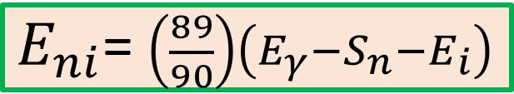
⁹⁰Zr(γ,n)⁸⁹Zr
γ-ray Beam Energies (MeV): 11.75, 12, 12.1, 12.2, 12.4, 12.5, 12.8, 13, 13.5
L=0
(s-wave neutrons)
MeV
1.451
5/2⁻
1⁻
13.5
13.4
1.095
3/2⁻
13.1
0.589
1/2⁻
ε_{ni}(E_{ni}) – neutron efficiency from Geant4
simulations
12.6
0
9/2⁺
11.97
E1
⁸⁹Zr
b_{i} – neutron branching from TALYS
calculations
S_{n}
0⁺
0
⁹⁰Zr

Slide 16
⁹⁰Zr(γ,n)⁸⁹Zr
A. Banu et al., Phys. Rev. C 99, 025802 (2019)

Slide 17
⁹⁰Zr(γ,n)⁸⁹Zr
1 excited state
1 excited state
2 excited states

Slide 18
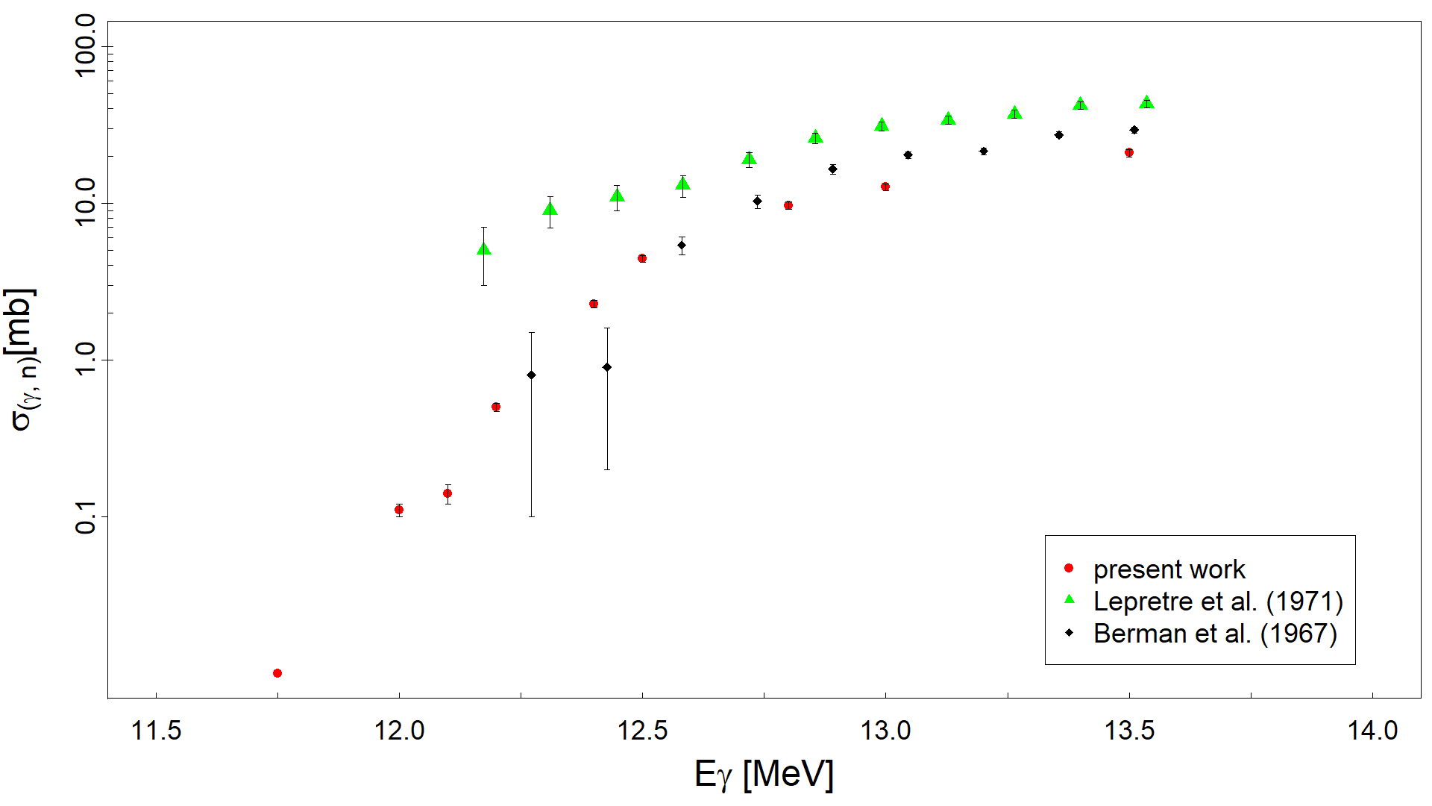
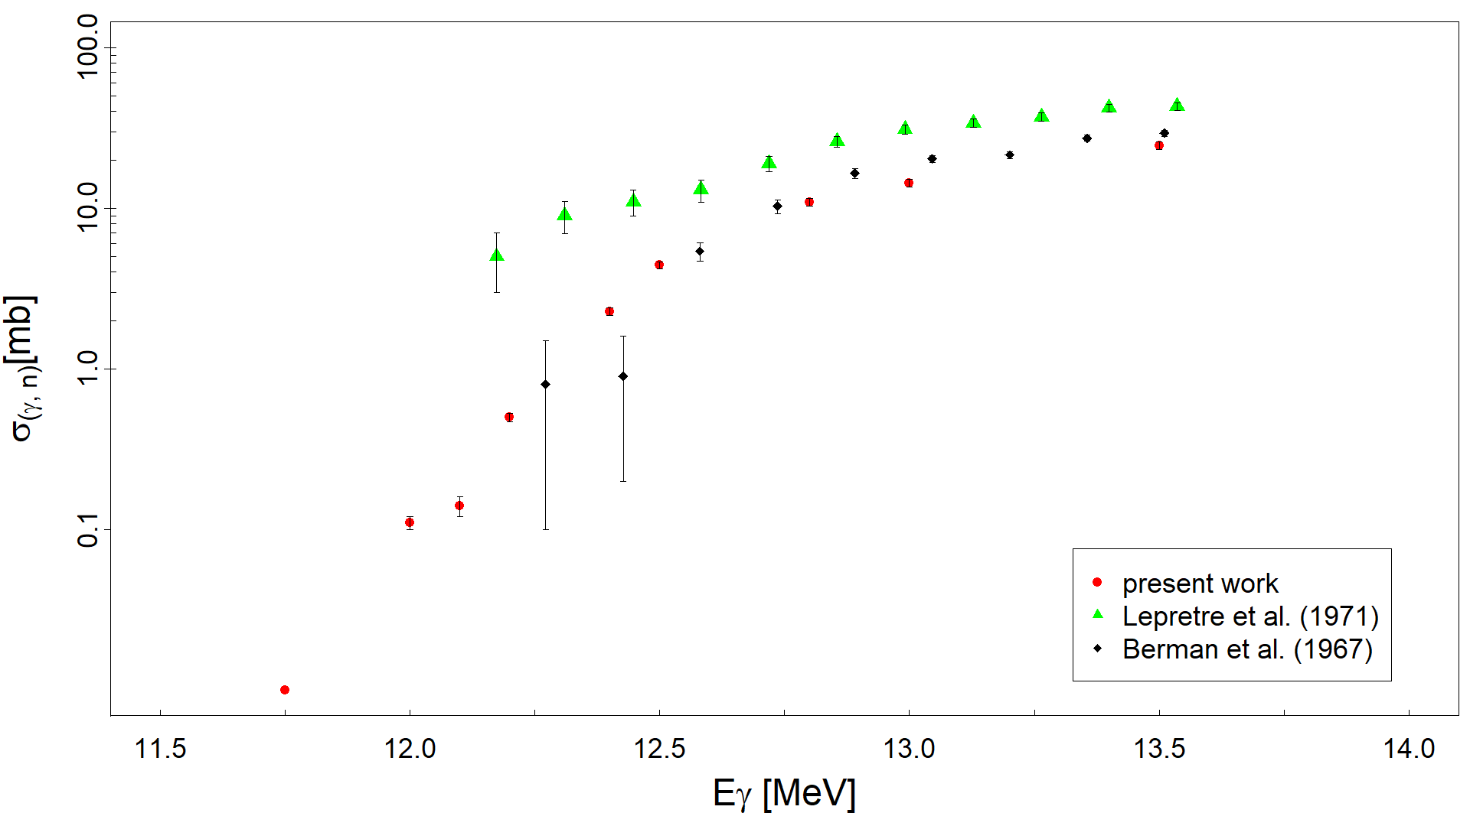
⁹⁰Zr(γ,n)⁸⁹Zr
only g.s. neutrons !!
12.8

Slide 19
⁹⁴Mo(γ,n)⁹³Mo
1 excited state
1 excited state
3 excited states
3 excited states
3 excited states
6 excited states
8 excited states
11 excited states
14 excited states
22 excited states

Slide 20
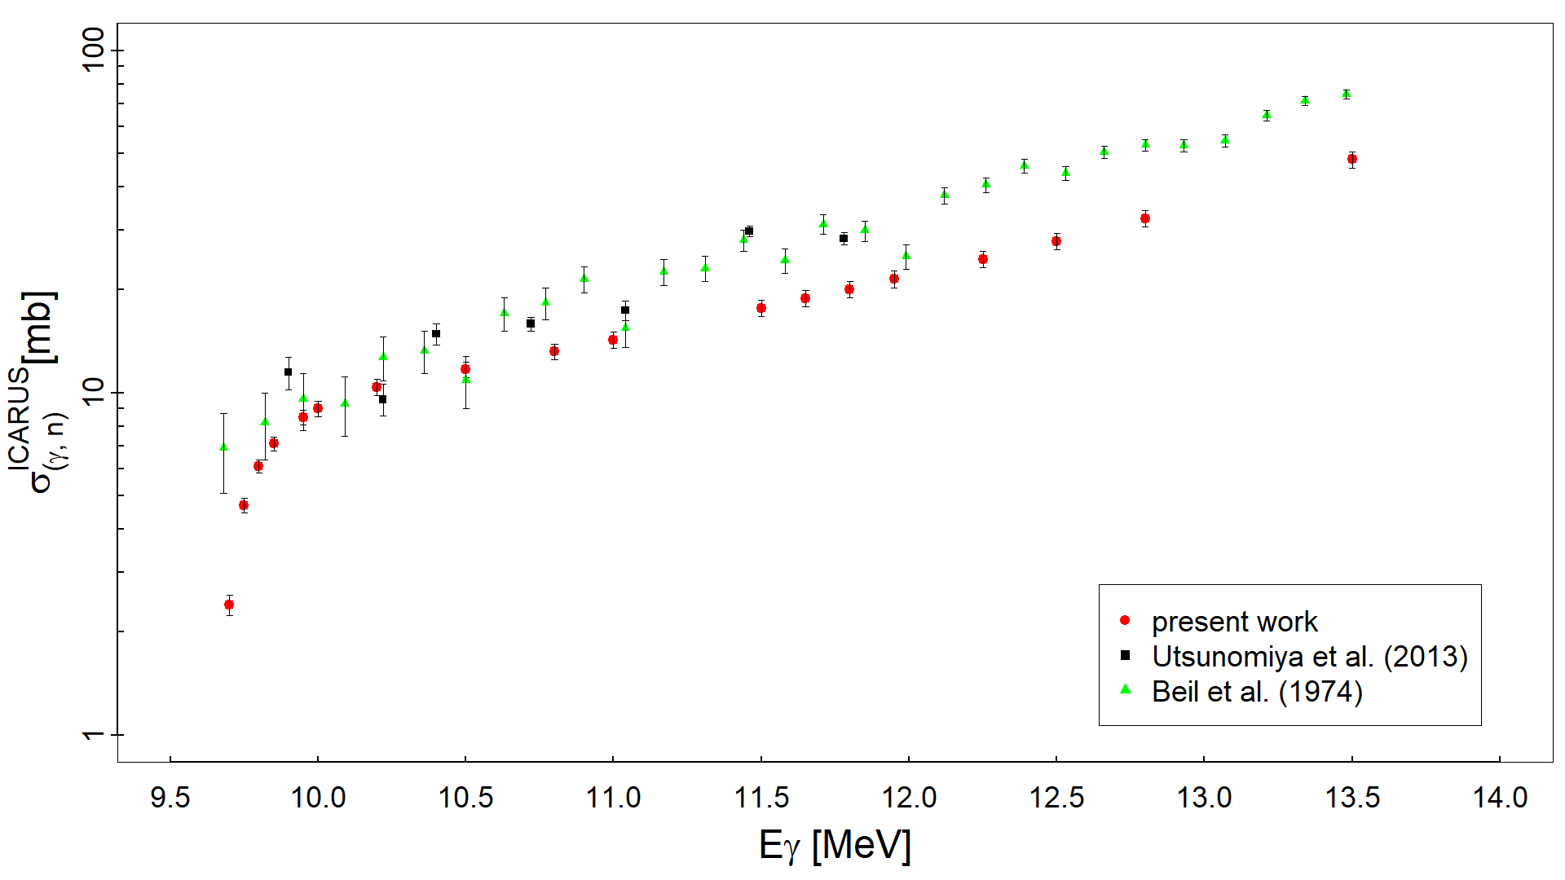
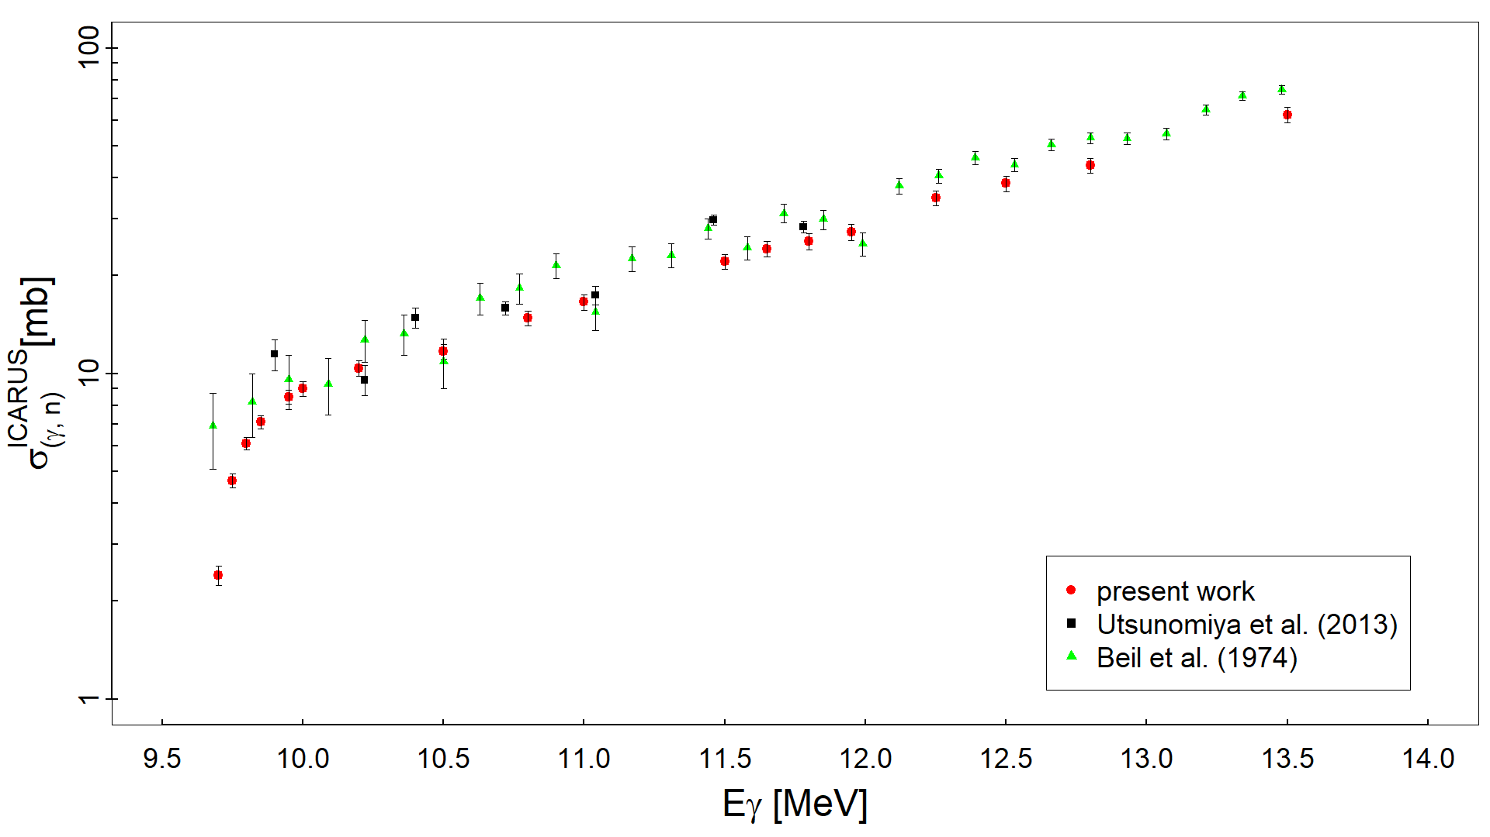
⁹⁴Mo(γ,n)⁹³Mo
only g.s. neutrons !!
10.8

Slide 21
A. Banu et al., Phys. Rev. C 99, 025802 (2019)

Slide 22
Messages to take away
Accurate measurements of cross sections of photoneutron reactions
help constrain the E1 γ-ray strength function models necessary for
calculating stellar photodisintegration reaction rates
  But these laboratory cross sections only determine a small fraction of the actual stellar reaction rate → they are not suited to directly constrain stellar photodisintegration reaction rates!
Neutrons emitted from excited states in the residual nucleus must be
appropriately accounted for when extracting laboratory photoneutron
reaction cross sections
  If only neutrons emitted from the ground state in the residual nucleus are considered, the photoneutron reaction cross sections can be overestimated!

Slide 23
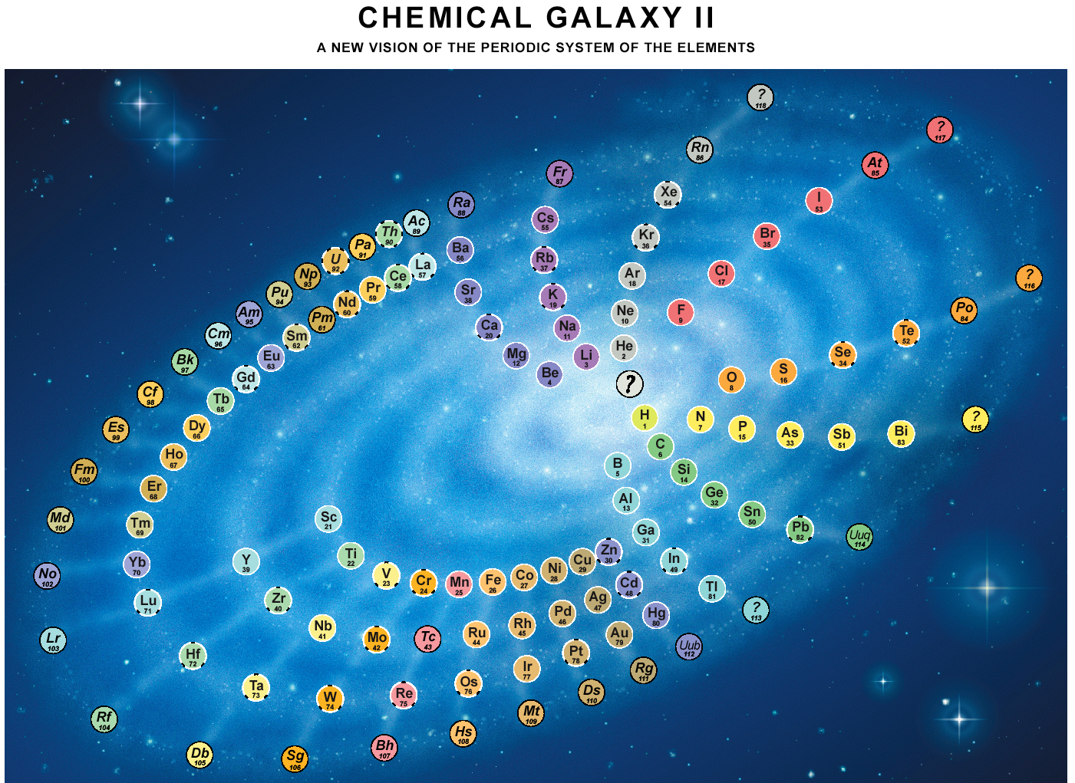
Just As Your Parents Told You
You Really Are Star Material !
Credit:
Joe Natowitz

Slide 24
“The most incomprehensible thing about the universe is that it is comprehensible.”
—Albert Einstein
Let’s do Physics!

Slide 25


The theoretical work was performed within the IAEA CRP on
“Updating the Photonuclear Data Library and Generating a Reference Database
for Photon Strength Functions” (F41032)
S. Goriely et al., Eur. Phys. J. A55, 172 (2019): Reference Database for Photon Strength Functions
T. Kawano et al., Nucl. Data Sheets 163, 109 (2020): IAEA Photonuclear Data Library 2019

