Slide 1



¹³⁰Te: A Cornucopia of Nuclear Structures
Sally F. Hicks
Tastes of Nuclear Physics 2020 - Hicks

Slide 2
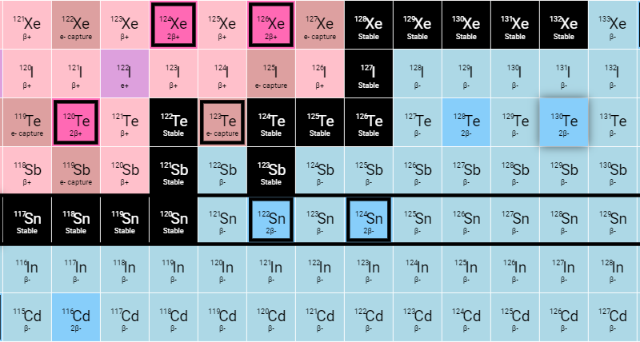
Why study ¹³⁰Te?
Neutrinoless double β decay (0νββ)
Nuclear structure study of the stable even-even Te isotopes using the (n,n′γ) reaction
¹³⁰Te → ¹³⁰Xe + 2β– ?
120Te
124Te
126Te
128Te
130Te
122Te
Tastes of Nuclear Physics 2020

Slide 3
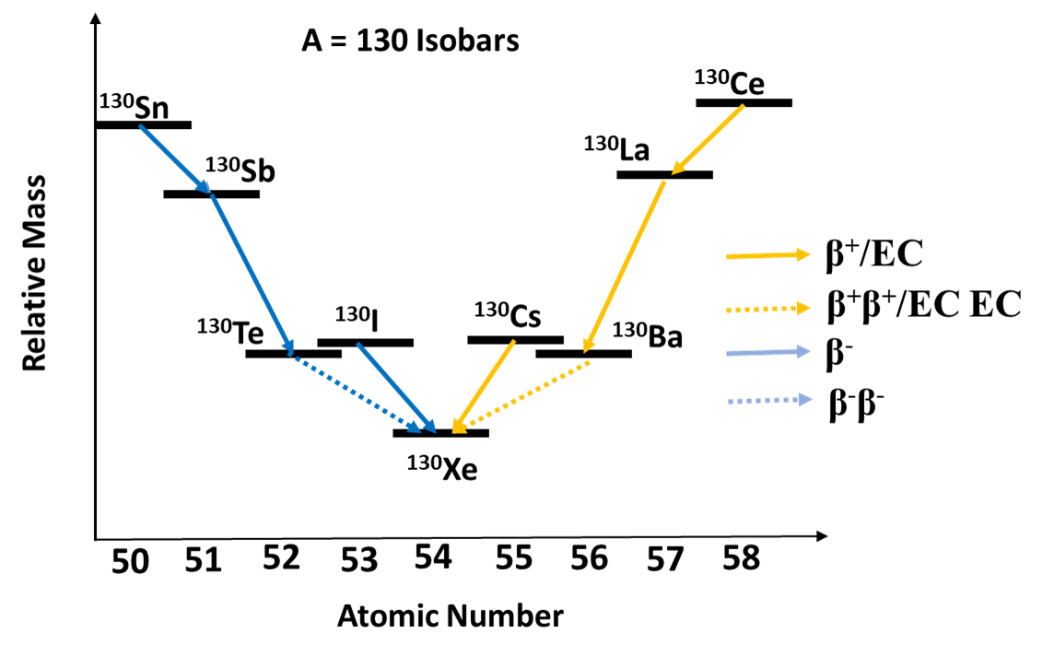
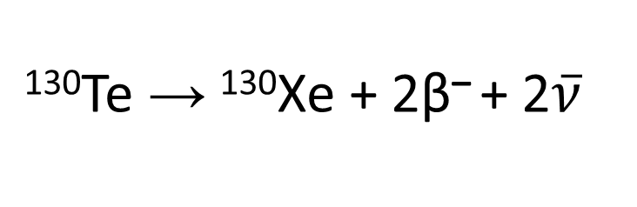
Normal double β decay (ννββ)
¹³⁰Te → ¹³⁰Xe + 2β– + 2$\overline{ν}$
First predicted by Maria Goeppert-Mayer in 1935 and allowed in the Standard Model:
ννββ first observed in 1950 in ¹³⁰Te using geochemical methods: T_{1/2} = 1.4 x 10²¹ y (Inghram and Reynolds, Phys. Rev 78, 822 (1950). Current value T_{1/2} = 8.2 x 10²⁰ y.
Tastes of Nuclear Physics 2020

Slide 4
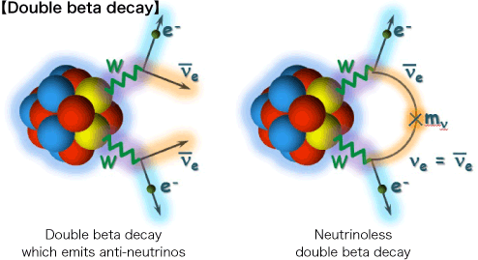
Neutrinoless double β decay (0νββ)
Neutrinoless double β decay (0νββ)
¹³⁰Te → ¹³⁰Xe + 2β– ?
Lepton number is not conserved.
0νββ process is outside the standard model.
Is the neutrino a Majorana particle?
Neutrino masses/properties better known?
https://wwwkm.phys.sci.osaka-u.ac.jp/en/research/r01.html (10/20/2020)
Tastes of Nuclear Physics 2020

Slide 5
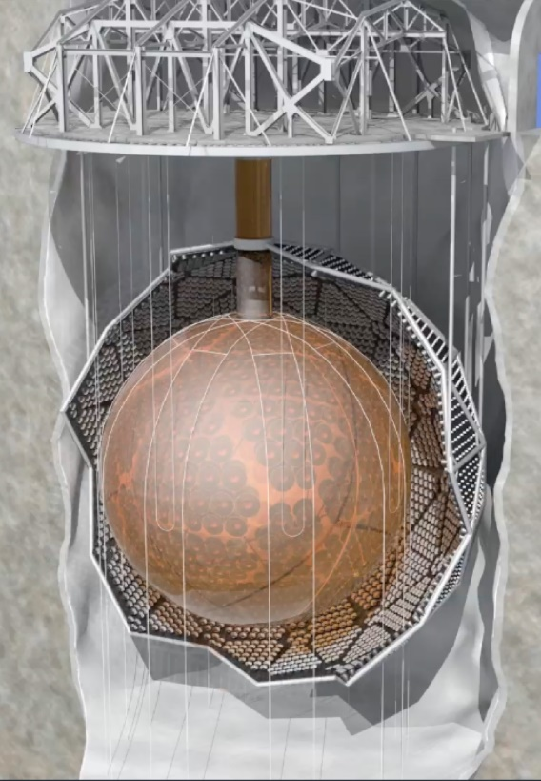
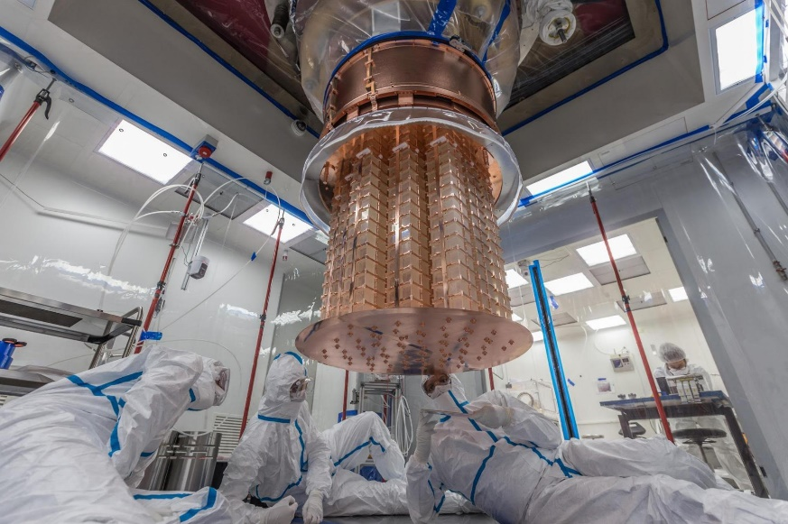
Why is ¹³⁰Te a good 0νββ candidate?
¹³⁰Te has the highest natural abundance of any of the 0νββ candidates. (34.08 %)
Q-value = 2527.518 ± 0.013 keV, which implies the half life might be short, making it easier to identify
Bolometers made from TeO₂ can be made extremely radiopure and they have an excellent energy resolution (0.2% at the 0νββ energy region of interest) (CUORE website). Current lower limit on the lifetime is 4.0 × 10²⁴ years at 90% C.L. (CUORE website: https://cuore.lngs.infn.it/en/about/detectors
Major experimental efforts
CUORE – Gran Sasso in Italy
SNO+ in Sudbury, Ontario, Canada
https://falcon.phy.queensu.ca/SNO+/about.html
https://newscenter.lbl.gov/2020/01/09/the-cuore-underground-experiment-narrows-the-search-for-rare-particle-process/
Tastes of Nuclear Physics 2020

Slide 6
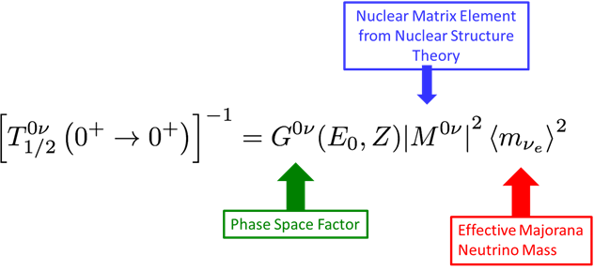
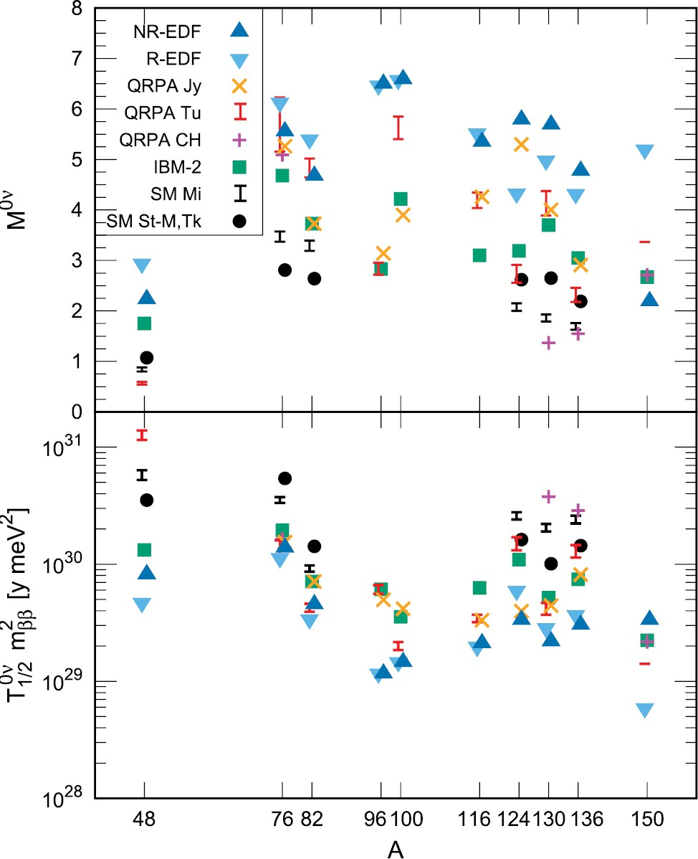
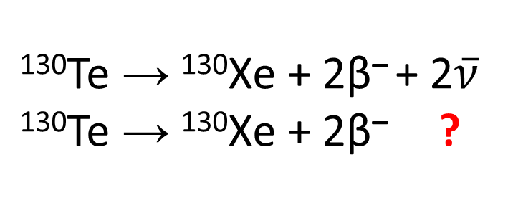
Comparison of calculated nuclear matrix elements for 0νββ candidates
¹³⁰Te → ¹³⁰Xe + 2β– + 2$\overline{ν}$
¹³⁰Te → ¹³⁰Xe + 2β– ?
M^{0ν}
The nuclear physics of the A = 130 Te and Xe nuclei needs to be better known.
J. Engel and J. Menendez, Reports on Progress in Physics 80, 046301 (2017).
Slide from S.W. Yates
Tastes of Nuclear Physics 2020

Slide 7
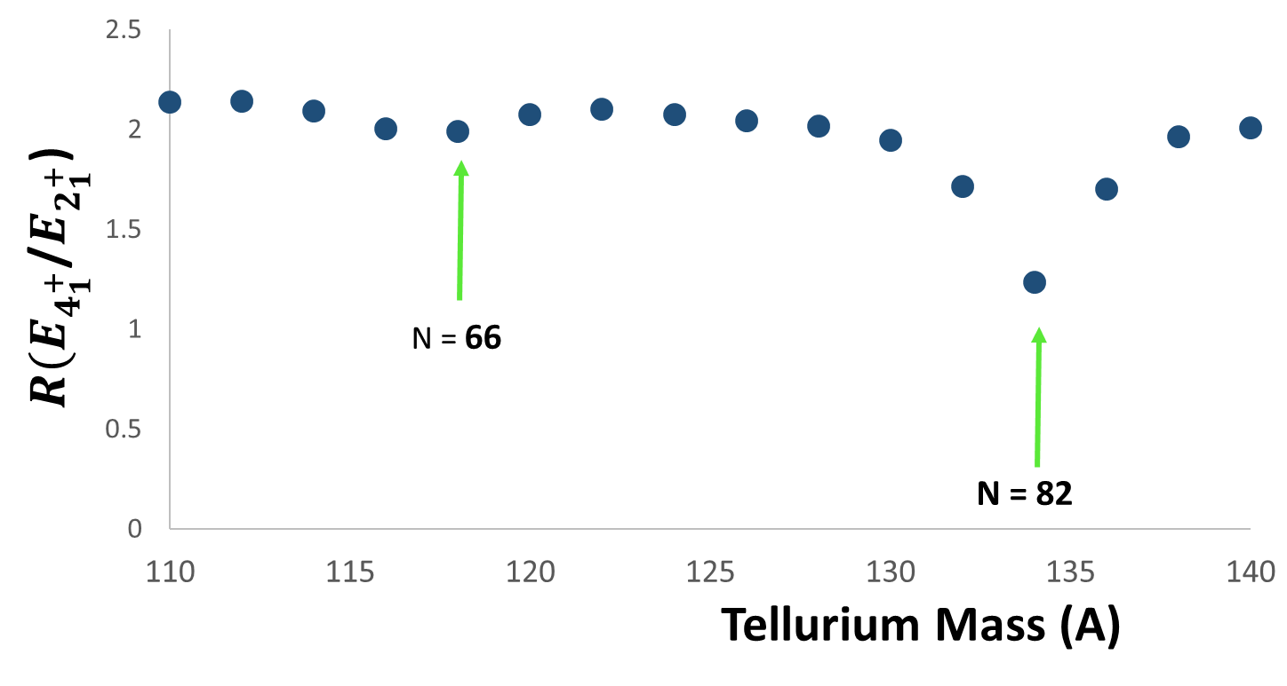
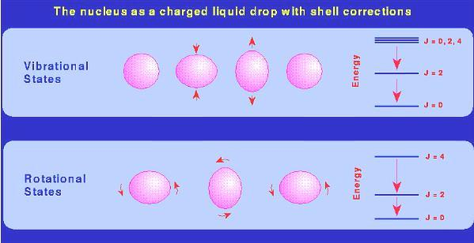
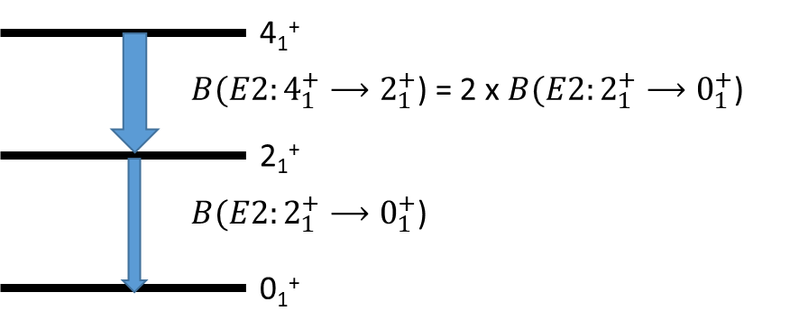
What is the underlying structure of the stable Tellurium nuclei?
¹¹⁸Te
¹³⁴Te
https://universe-review.ca/F14-nucleus02.htm
The ratio R_{4/2} = E(4⁺₁)/E(2⁺₁) is
    “vibrational” for 2 < R_{4/2} < 2.2,
    “transitional” for R_{4/2} ≈ 2.7,
    “rotational” for R_{4/2} ≈ 3.3, and
    “shell configurations” for R_{4/2} < 2
Tastes of Nuclear Physics 2020

Slide 8
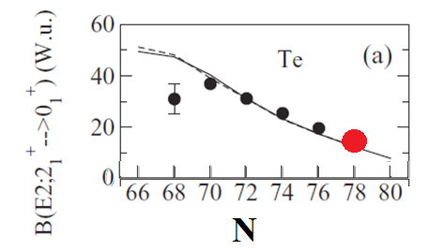
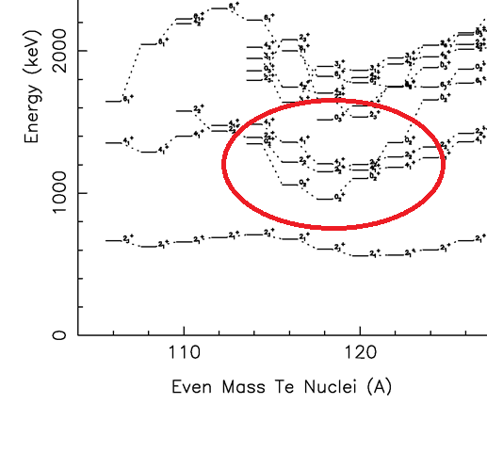
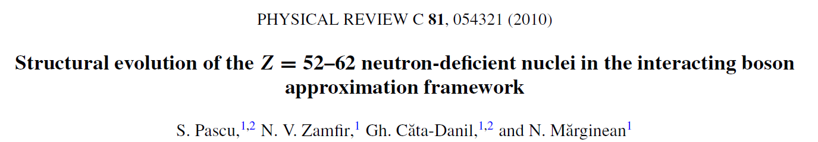
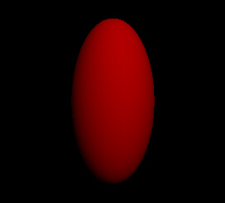
Te: Vibrational Nuclei or Not Vibrational Nuclei??
Quadrupole Vibration
Tastes of Nuclear Physics 2020

Slide 9
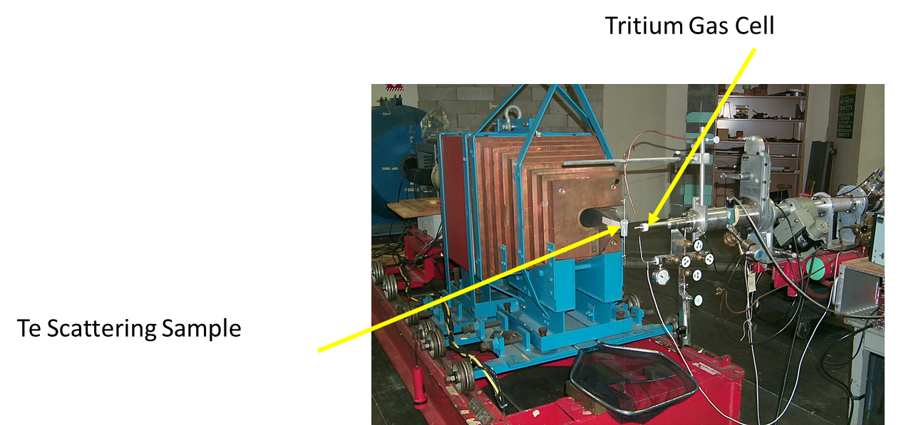
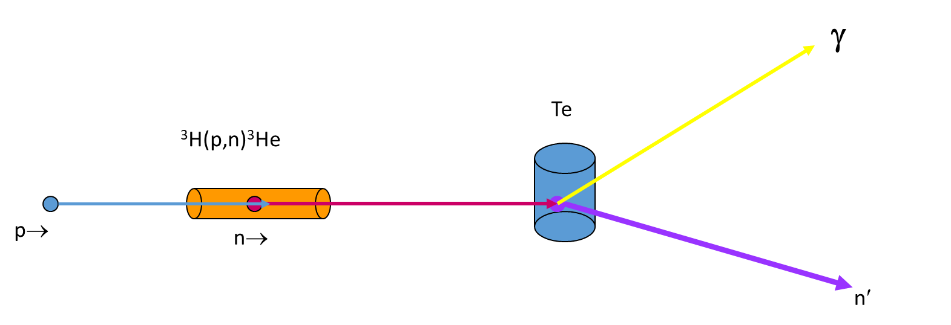
Using the (n,n´γ) reaction to learn more about ¹³⁰Te at UKAL
Neutron probes have no Coulomb barrier to overcome. You can study levels near threshold.
The reaction is non-selective exciting all levels with spin J ≤ 6.
Excellent γ-ray detectors are available to resolve levels separated by < 2 keV.
Measure Doppler-shifts → deduce level lifetimes and reduced transition probabilities → needed for model comparisons.

Slide 10
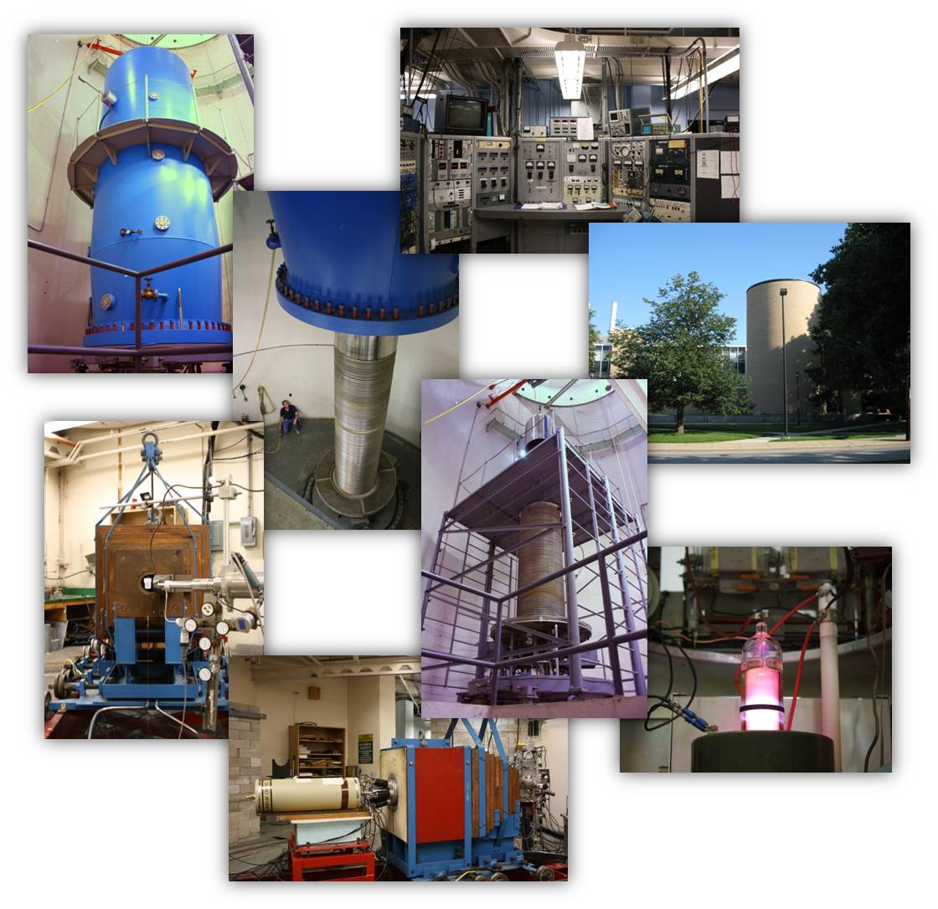
Experimental Details
All measurements were completed at the University of Kentucky Accelerator Laboratory using the (n,n′γ) reaction.
On an enriched ¹³⁰Te sample (50 g metallic: 99.47% enrichment:
d = 2.2 cm, h= 4 cm):
  γ-ray excitation functions from E_{n} = 1.90 to 3.44 MeV
  γ-ray angular distributions at E_{n} = 2.2 and 3.3 MeV
      Level energies, spins and some parities
      γ-ray branching and multipole-mixing ratios
      Doppler Shifts
On a natural Te sample:
  γγ coincidence measurements using the Kentucky Gamma-ray Spectrometer (KEGS)
Tastes of Nuclear Physics 2020

Slide 11
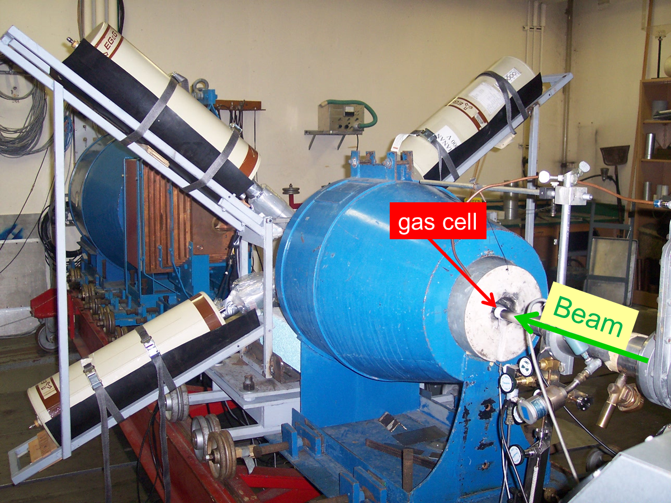
KEGS
Scattering Sample
HPGe
HPGe
HPGe
HPGe
Lithium Carbonate
Loaded Paraffin
Paraffin-Filled Shielding
Gas Cell
γ-γ coincidences at E_{n}≈3.4 MeV
Coincidence detectors – four high-purity Ge detectors without Compton suppression.
Beam →
Kentucky Gamma-ray Spectrometer
KEGS

Slide 12
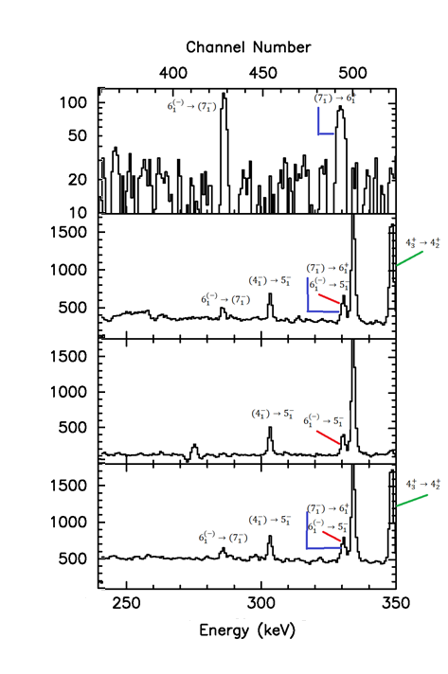
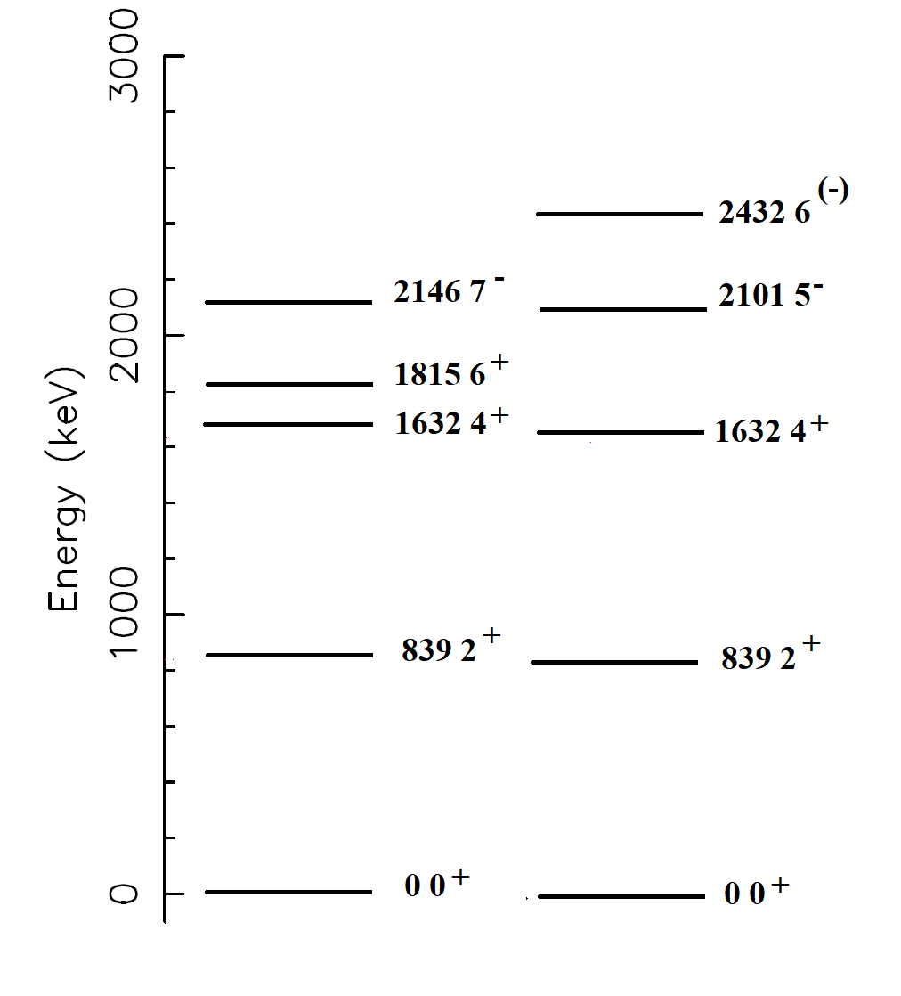
Advantage of γγ Coincidence Measurements
Gate 182
E_{γ} = 331 keV
Gate 793
E_{γ} = 331 keV
γ(468)
γ(182)
Counts
Gate 468
γ(793)
γ(793)
Gate 839
γ(839)
γ(839)
¹³⁰Te
Tastes of Nuclear Physics 2020 - Hicks

Slide 13
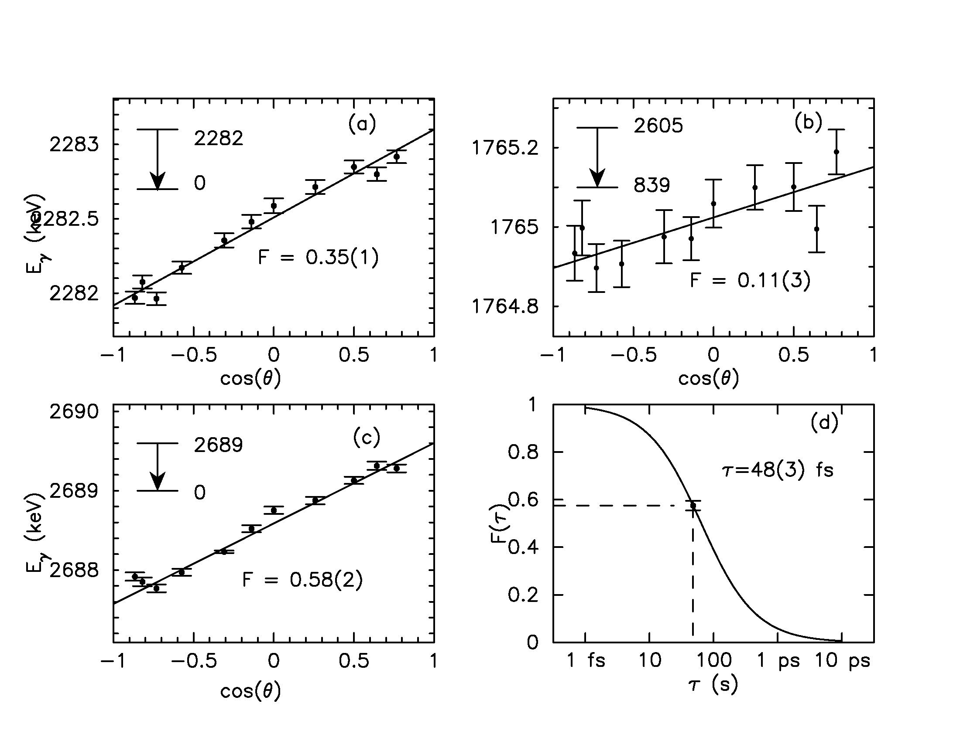
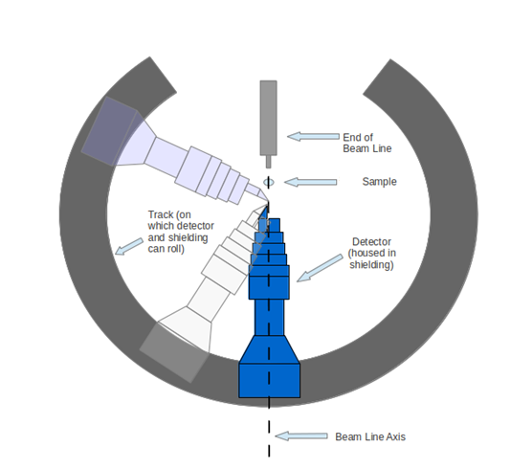
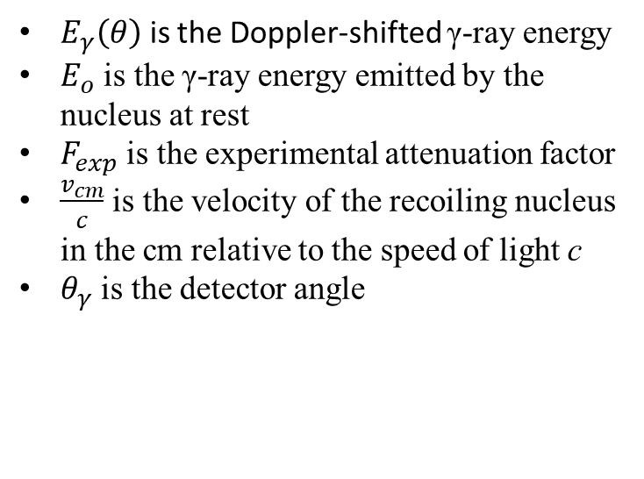
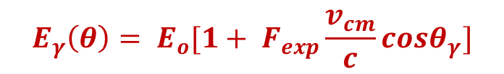
Observed Doppler Shifts in ¹³⁰Te
Red shifts
Blue shifts
$$E_{γ}\left(θ\right)= E_{o}[1+ F_{exp}\frac{v_{cm}}{c}cosθ_{γ}]$$
$E_{γ}\left(θ\right)$ is the Doppler-shifted γ-ray energy
$E_{o}$ is the γ-ray energy emitted by the nucleus at rest
$F_{exp}$ is the experimental attenuation factor
$\frac{v_{cm}}{c}$ is the velocity of the recoiling nucleus in the cm relative to the speed of light c
$θ_{γ}$ is the detector angle
V_{cm}/c ≈ 0.001 produces observable Doppler shifts; few fs < τ < few ps; Winterbon stopping theory used to deduce τ from F(τ)
T. Belgya, G. Molnár, and S. W. Yates, Nucl. Phys. A607, 43 (1996).
Tastes of Nuclear Physics 2020 - Hicks

Slide 14
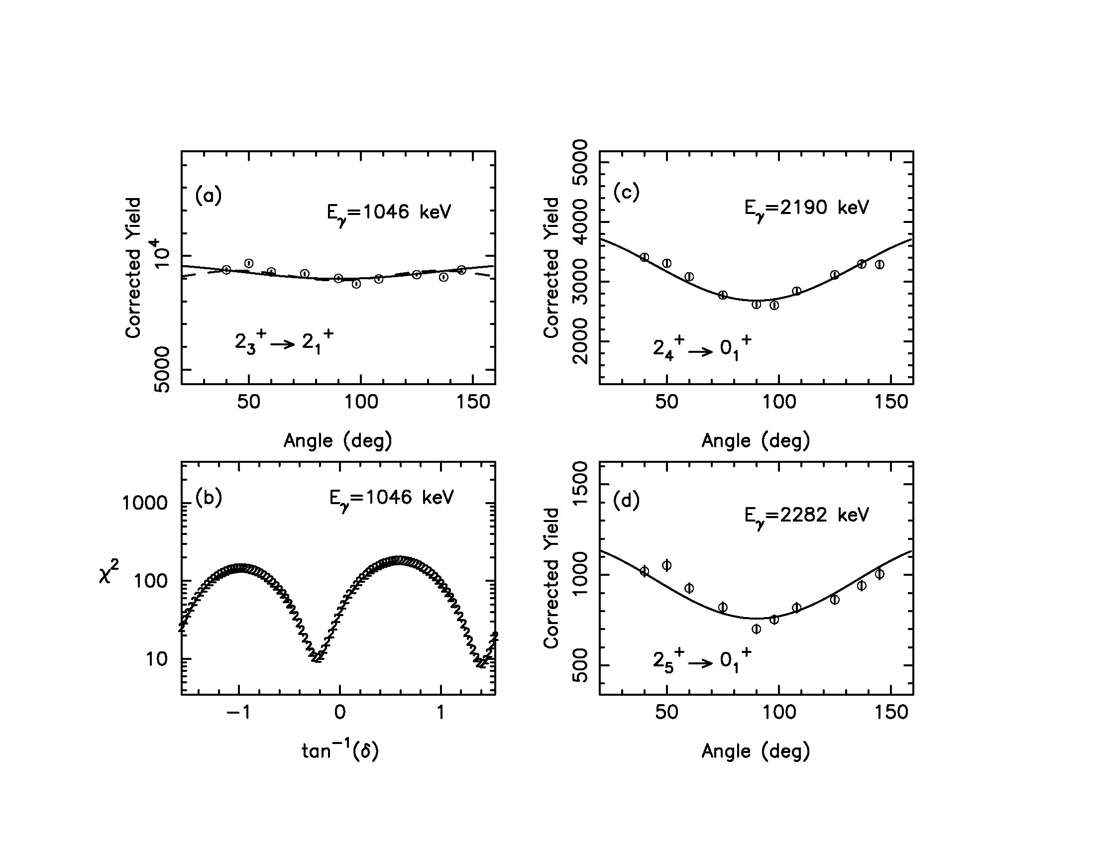
Verified the lowest 2⁺ excitations in ¹³⁰Te
Determined multipole-mixing ratios
Phys. Rev. CC 78, 054320 (2008).
Tastes of Nuclear Physics 2020 - Hicks

Slide 15
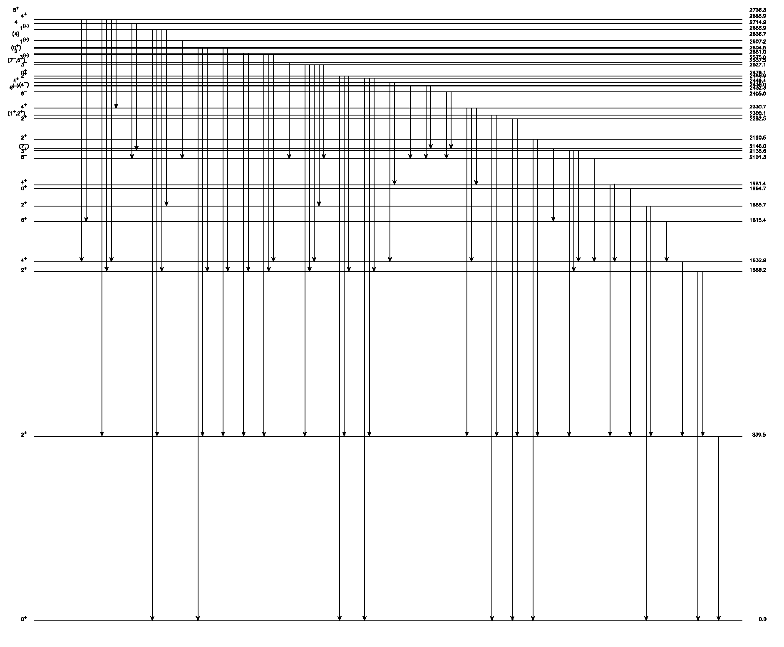
Levels and transitions to 3.4 MeV
Many new levels and transitions found, especially above 2.7 MeV
Branching and multipole-mixing ratios
Spins and some parities
New lifetimes: deduce B(M1), B(E1), and B(E2) values
Preliminary
Now What!
¹³⁰Te
Tastes of Nuclear Physics 2020 - Hicks

Slide 16
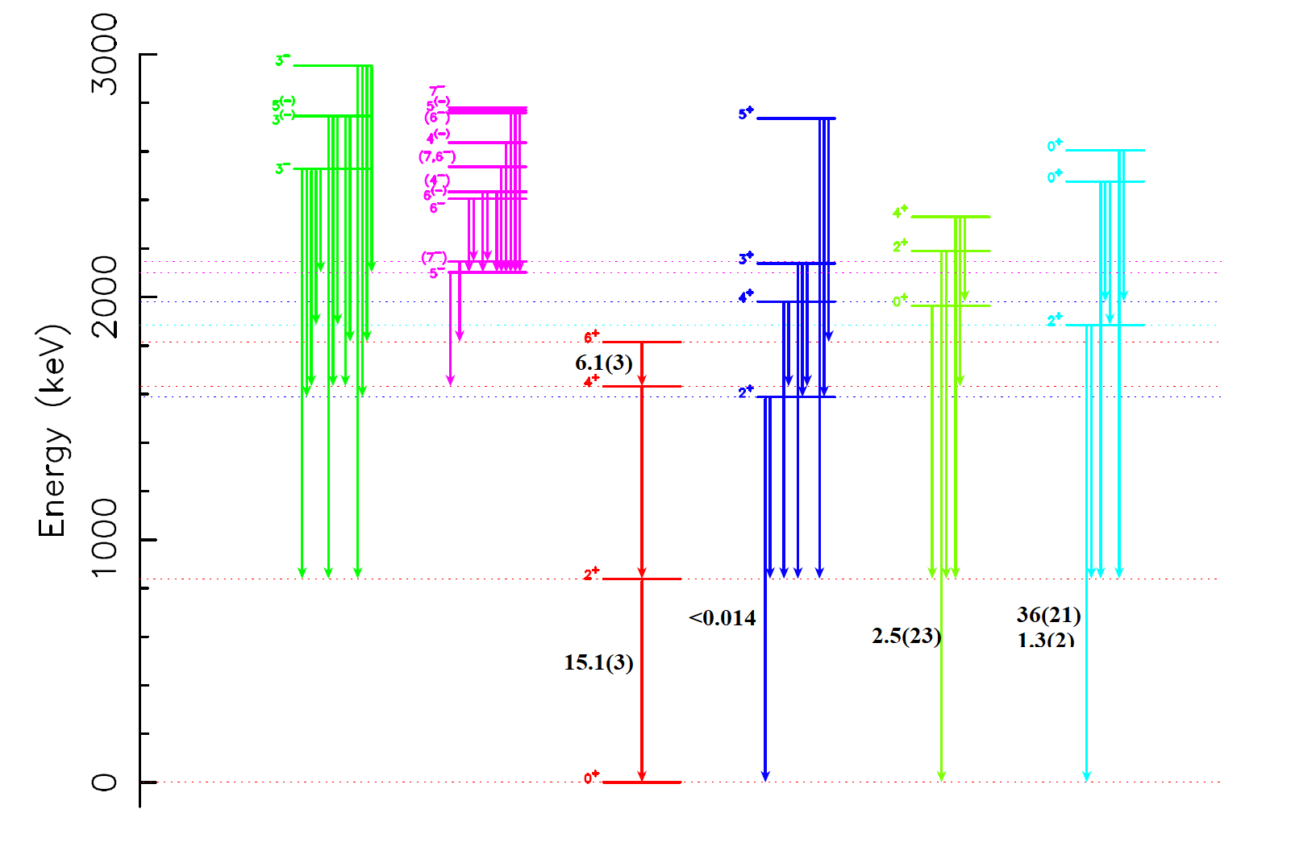
Collections of States in ¹³⁰Te
What are some things that seem to be well understood?
A gaze across the isotopic chain helps us understand underlying structures.
Tastes of Nuclear Physics 2020 - Hicks

Slide 17
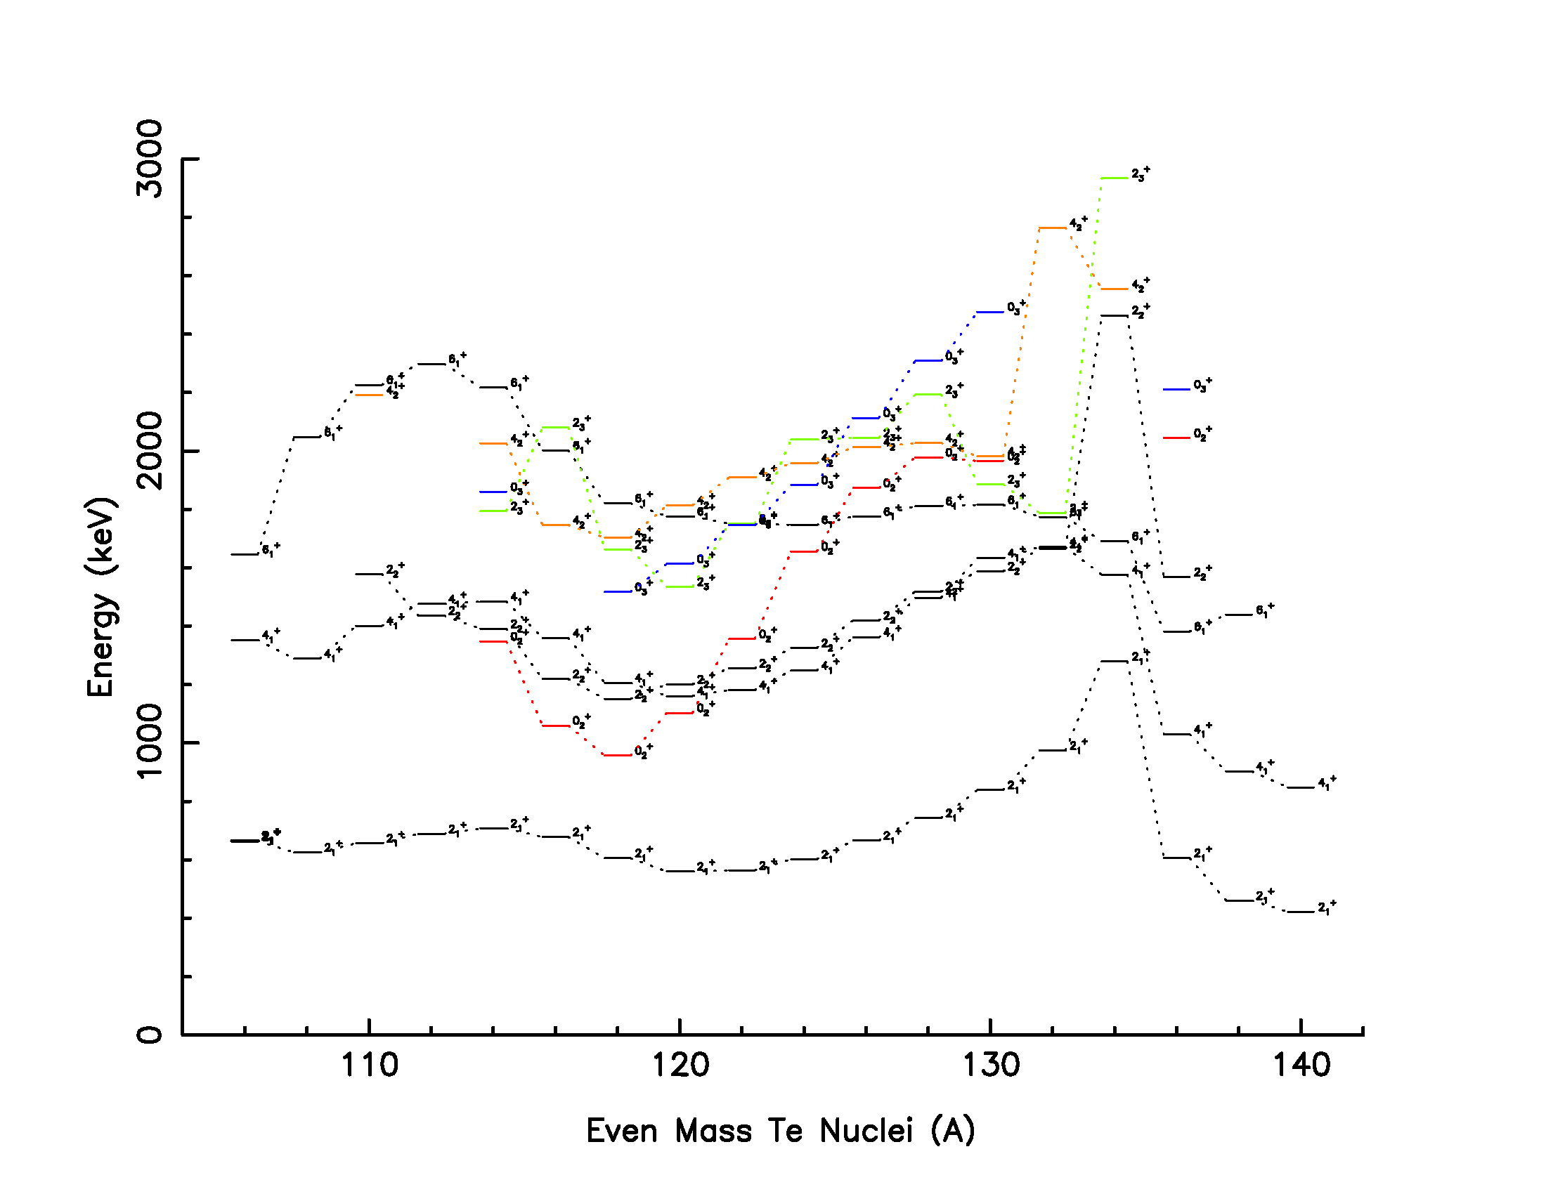
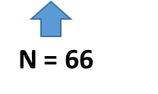
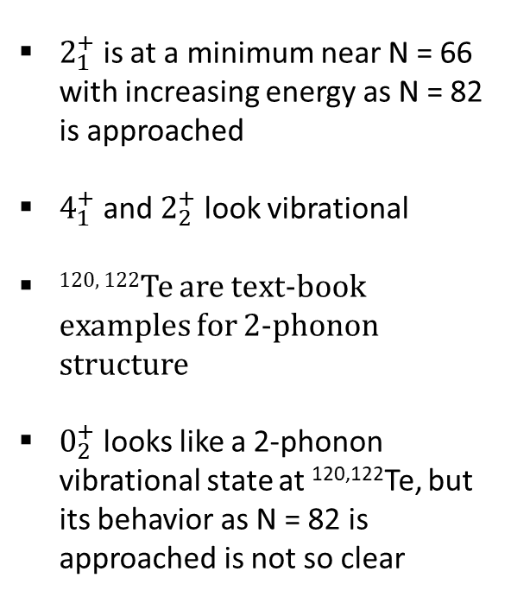
$2_{1}^{+}$ is at a minimum near N = 66 with increasing energy as N = 82 is approached
$4_{1}^{+}$ and $2_{2}^{+}$ look vibrational
^{120, 122}Te are text-book examples for 2-phonon structure
$0_{2}^{+}$ looks like a 2-phonon vibrational state at ^{120,122}Te, but its behavior as N = 82 is approached is not so clear
N = 82
Tastes of Nuclear Physics 2020 - Hicks

Slide 18
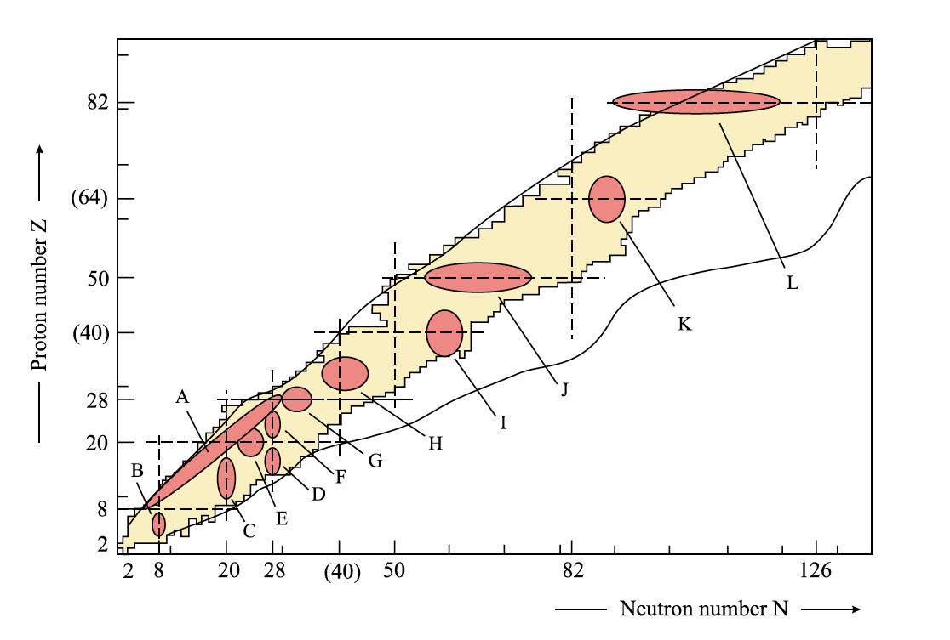
Shape Coexistence in the Te nuclei?
¹³⁰Te
Need level lifetimes to address many structural questions in the Te nuclei.
K. Heyde and J. L. Wood, Rev. Mod. Phys. 83, 1467 (2011).

Slide 19
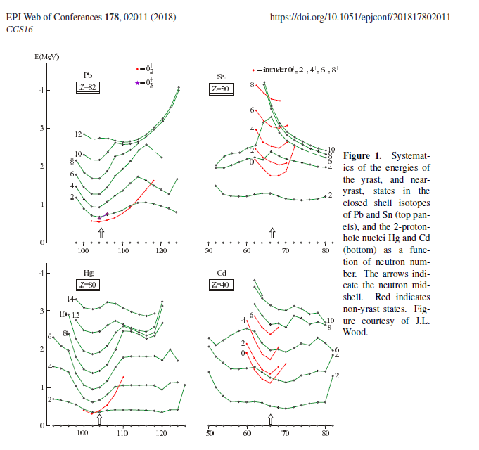
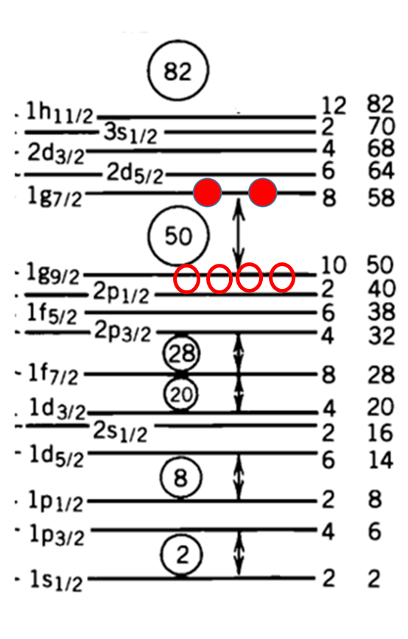
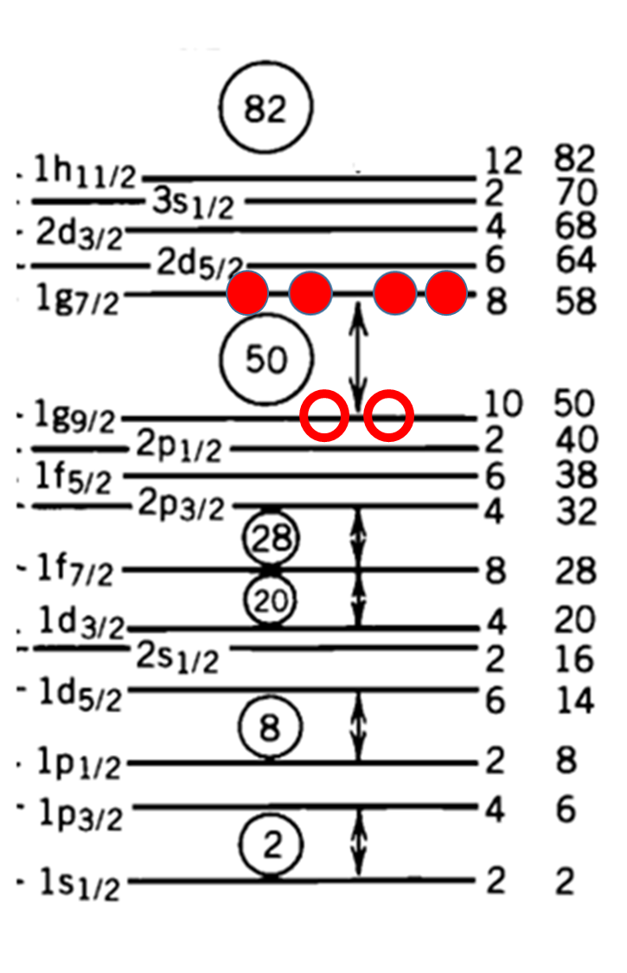
P.E. Garrett
Shape Coexistence in the Z = 50 Region
2p – 2h
2p – 4h
Cd Nuclei
Te Nuclei
Tastes of Nuclear Physics 2020 - Hicks

Slide 20
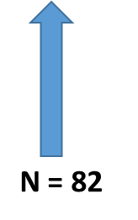
Systematics of yrast and near-yrast states in the Te nuclei. The arrows indicate the neutron midshell at N = 66 and closed shell at N = 82.
Tastes of Nuclear Physics 2020 - Hicks

Slide 21
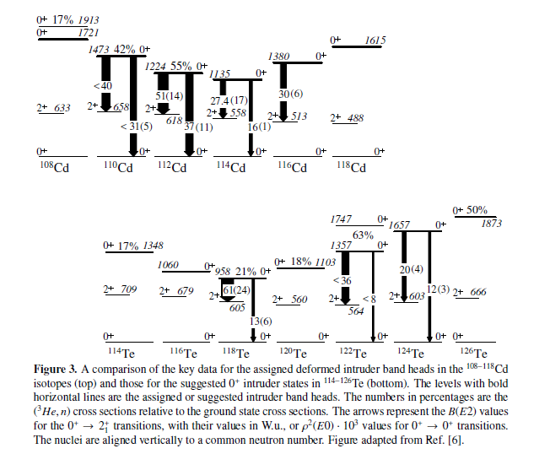
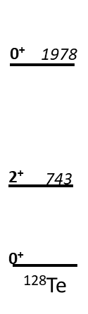
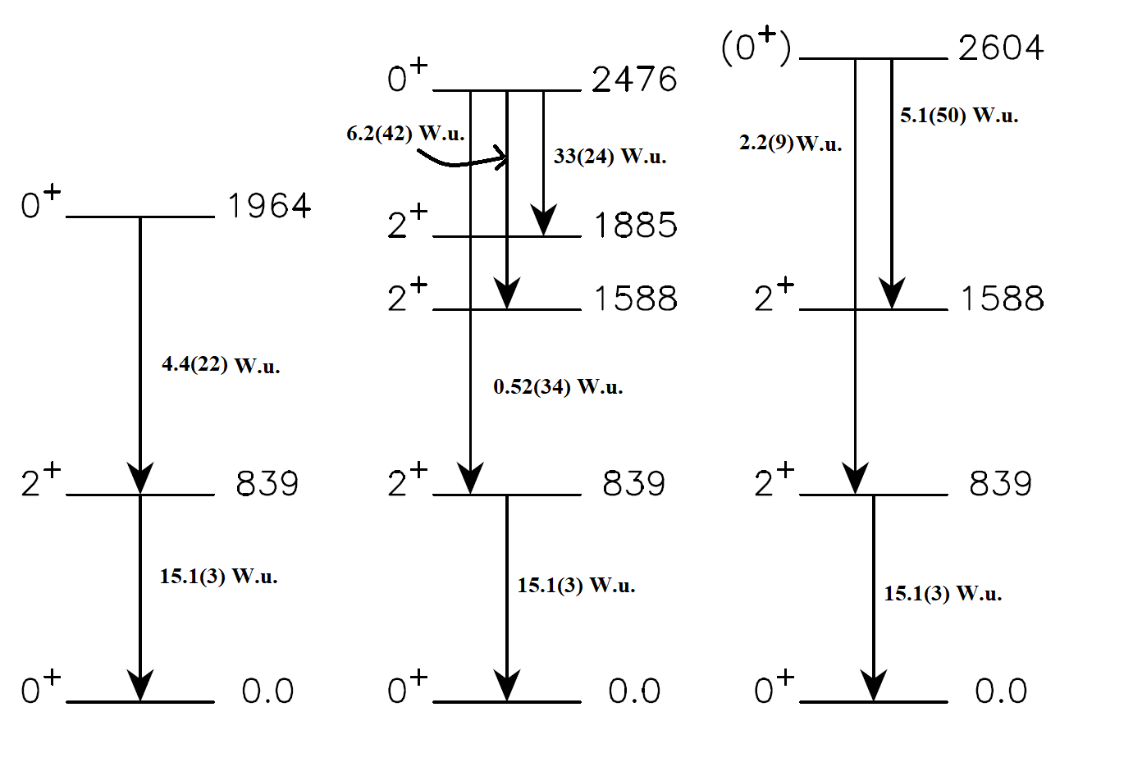
Observed 0⁺ states in ¹³⁰Te
Preliminary
¹³⁰Te
P. E. Garrett
The jury is still out!
Tastes of Nuclear Physics 2020 - Hicks

Slide 22
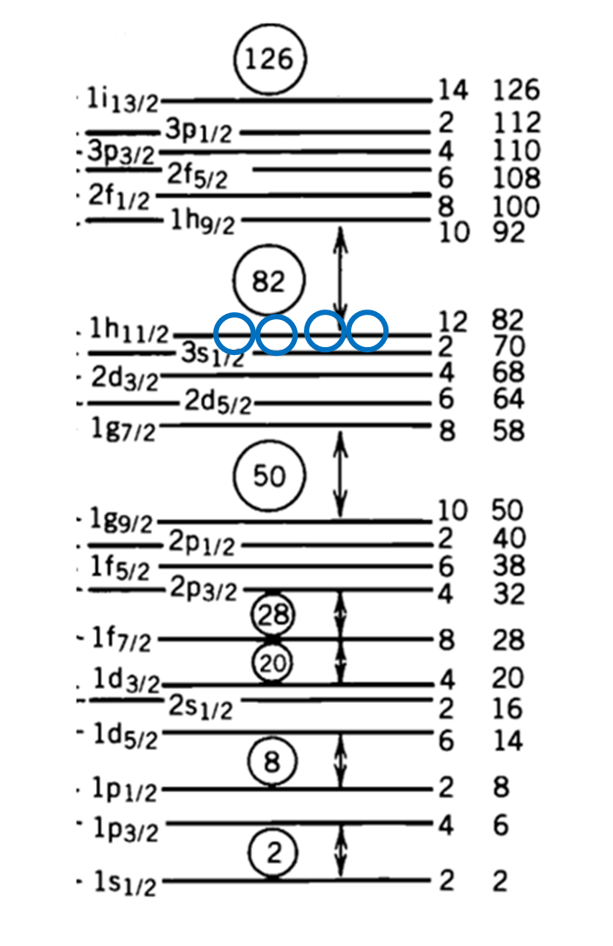
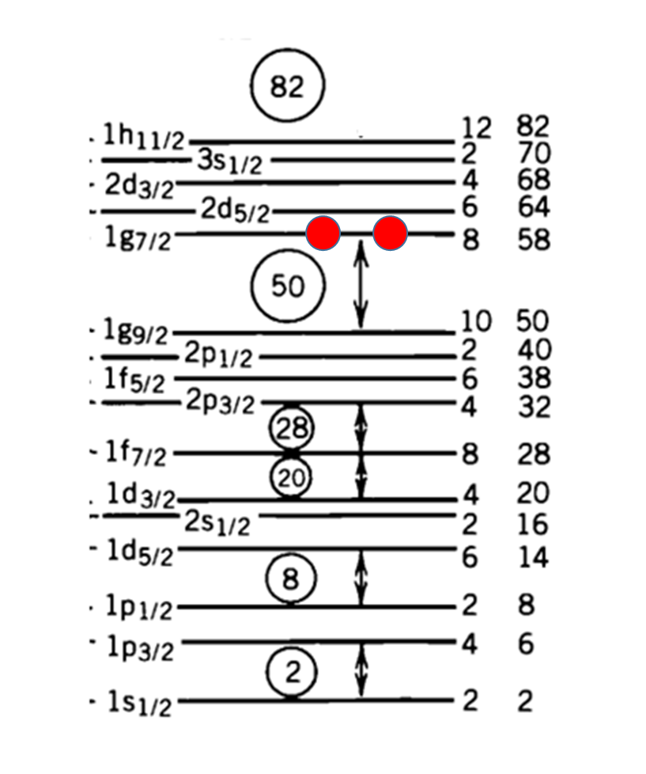
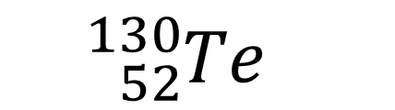
Shell Model: A lens through which to look at interesting structures
Protons
¹³⁴Te
¹²²Te
¹¹⁶Te
${}_{52}^{130}{Te}$
Neutrons
Tastes of Nuclear Physics 2020

Slide 23
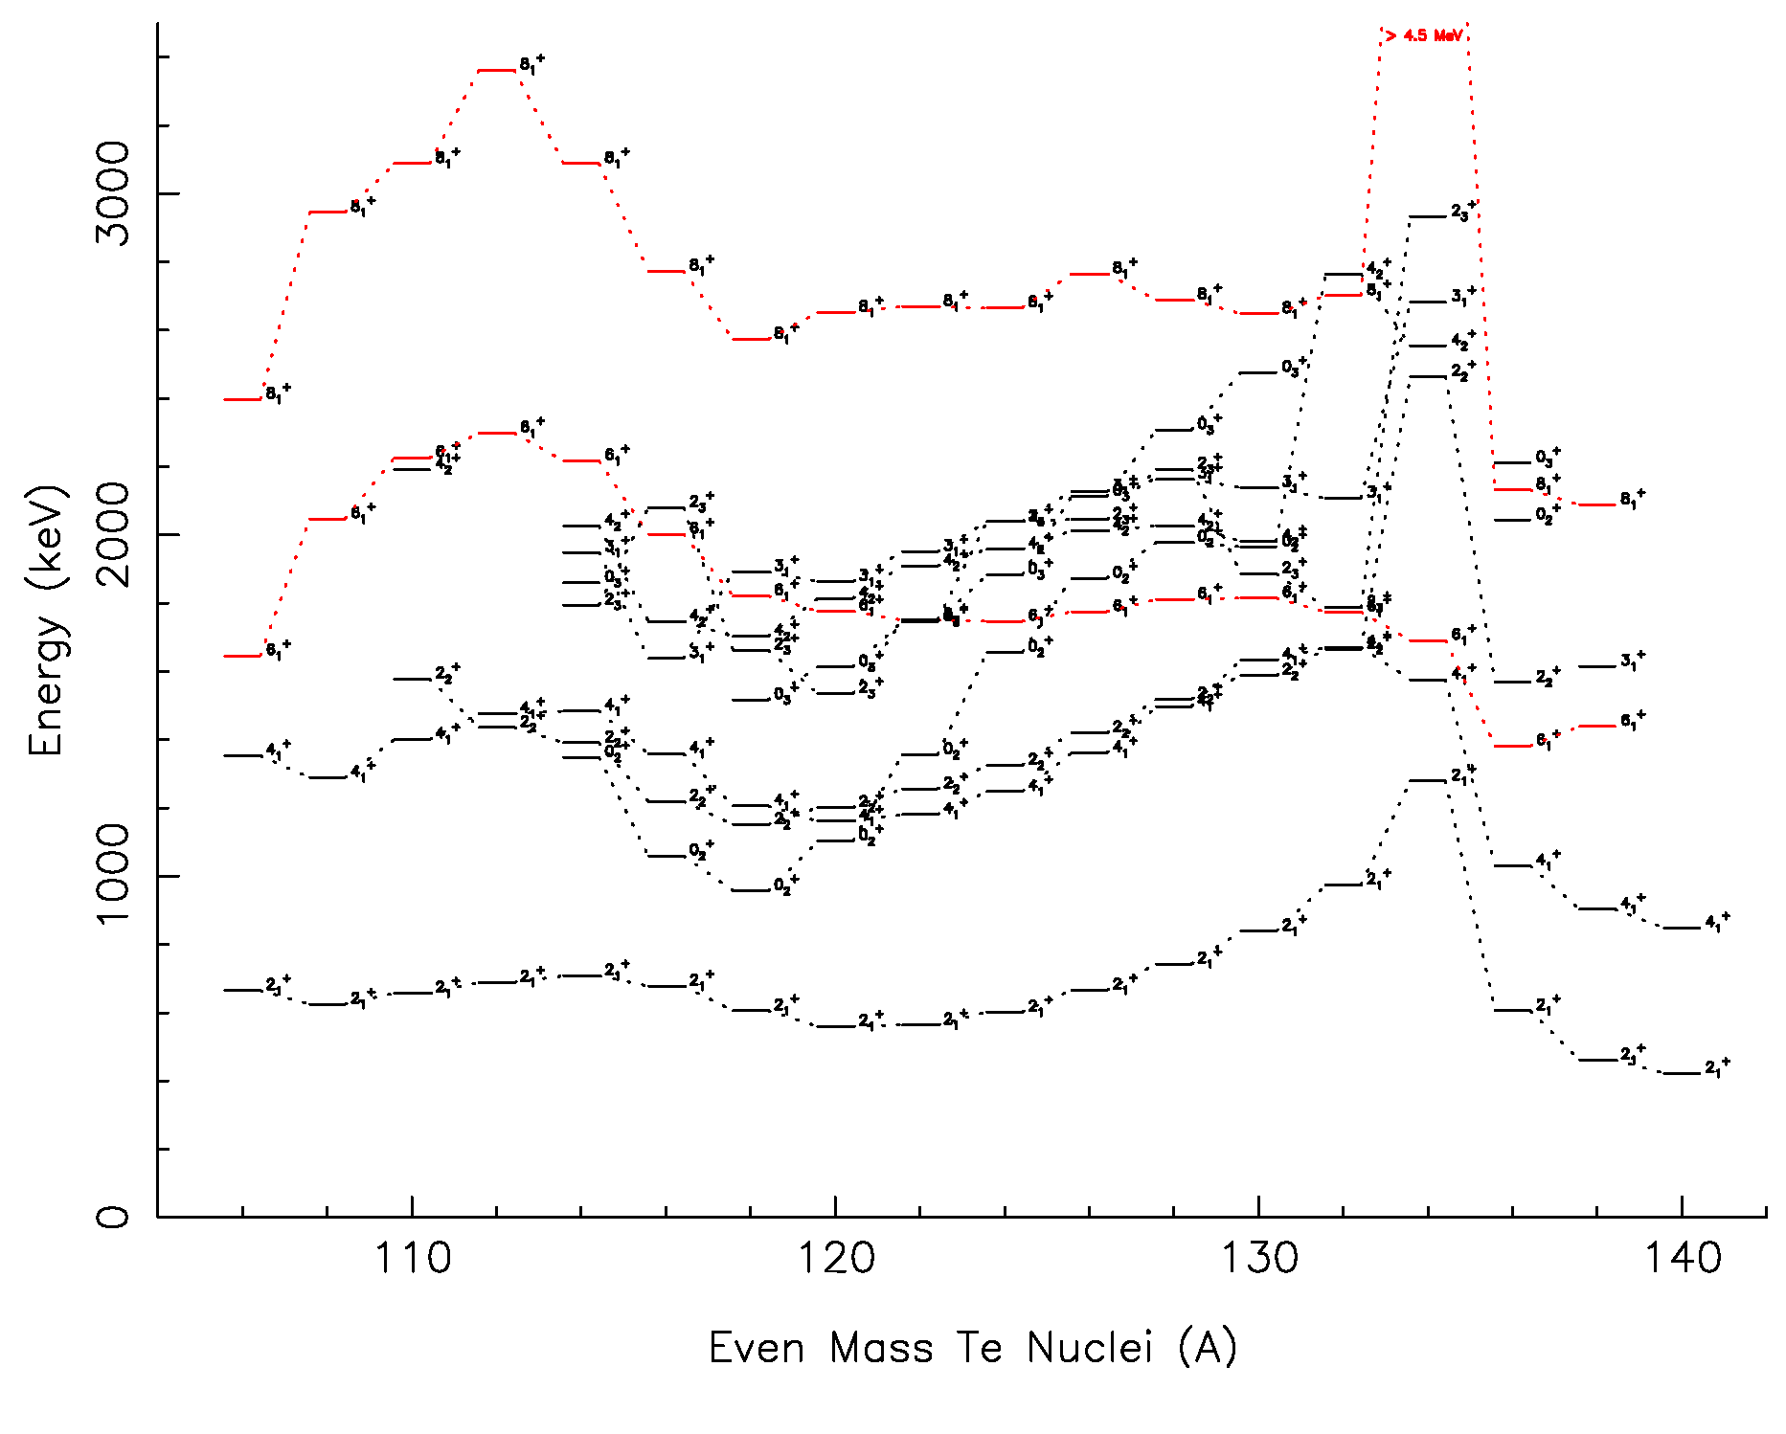
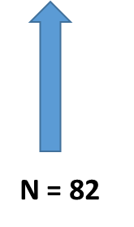
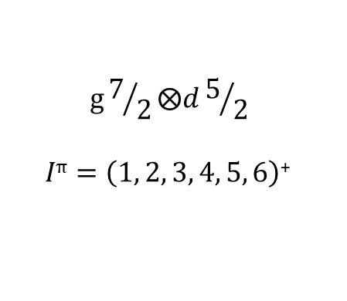
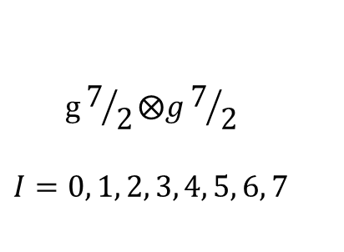
6₁⁺ - two-proton particle excitation
$$g7/2⨂g7/2$$
$$I=0, 1, 2, 3, 4, 5, 6, 7$$
$$g7/2⨂d5/2$$
$Iπ=\left(1, 2, 3, 4, 5, 6\right)$⁺
Tastes of Nuclear Physics 2020 - Hicks
Notes:
The 8+, likewise, is probably from the 2n configuration of (h11/2)^2.

Slide 24
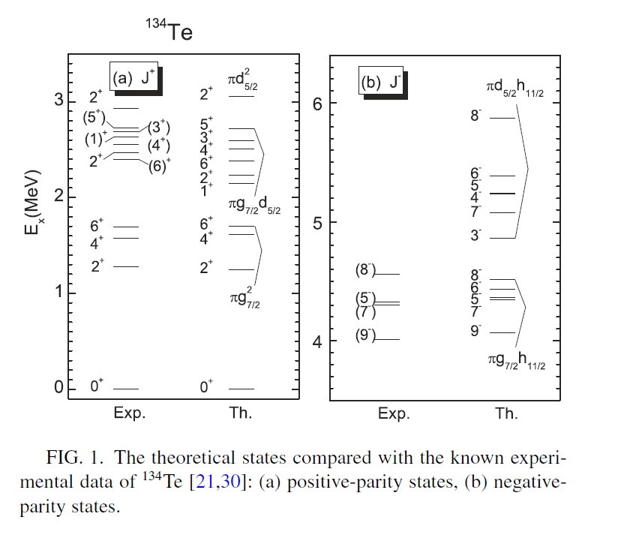
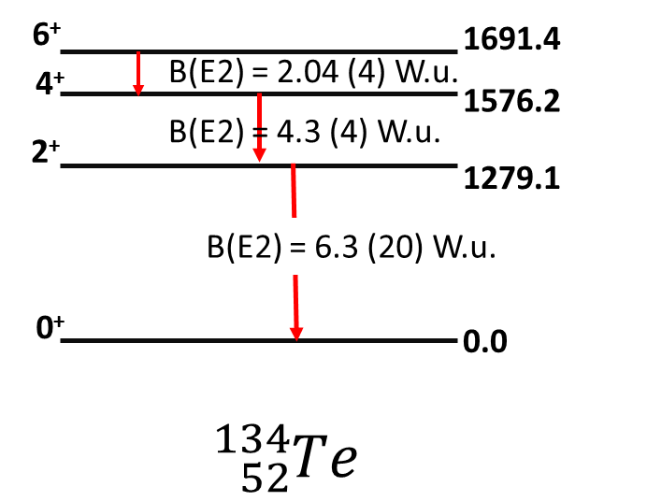
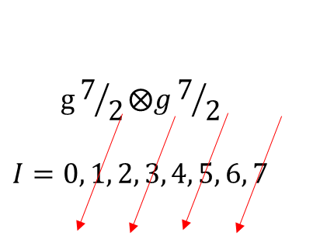
H.K. Wang et al., Phys. Rev. C 102, 054316 (2020).
Tastes of Nuclear Physics 2020 - Hicks

Slide 25



Protons
Negative Parity States in ¹³⁴Te
neutrons
$$g_{7/2}⨂h_{11/2}$$
I^{π} = 2⁻, 3⁻, 4⁻, 5⁻, 6⁻ , 7⁻, 8⁻, 9⁻
J. P. Omtvedt et al., Phys. Rev. Lett. 75, 1995.
Tastes of Nuclear Physics 2020 - Hicks

Slide 26


How are low-lying negative parity excitations formed across the Te isotopic chain?
s, p, d, f, g, h, i l = 0,1,2,3,4,5,6
Parity = (-1)^{l}
The lowest negative-parity excitations across the Te chain of stable isotopes are the 5⁻ and 7⁻ non-collective levels.
5⁻ : ${ h}_{11/2}⨂{s_{1/2} or h_{11/2}⨂d_{3/2}}$
Particle-hole configurations
7⁻ : $h_{11/2}⨂d_{3/2}$
Protons
What indicates these states are non-collective?
Neutrons
Tastes of Nuclear Physics 2020 - Hicks

Slide 27




Dominant Configurations
7⁻ : $h_{11/2}⨂d_{3/2}$
5⁻ : ${ h}_{11/2}⨂{s_{1/2} }$
Energy (keV)
Expanded from A. Kerek, Nucl. Phys. A176, 466 (1971). Energies for Te nuclei from NNDC ENSDF.
A
Tastes of Nuclear Physics 2020 - Hicks

Slide 28


Decays to the lowest 5⁻ states in ^{124,130}Te nuclei
γ-ray Relative Production Cross Sections
Neutron Energy (MeV)
Tastes of Nuclear Physics 2020 - Hicks

Slide 29
Octupole vibration?
Tastes of Nuclear Physics 2020 - Hicks

Slide 30


Lowest 3⁻ is not the most collective 3⁻ in ¹³⁰Te.
M. Matoba et al., Nucl. Phys. A237, 260 (1975)
Tastes of Nuclear Physics 2020 - Hicks

Slide 31





The lowest 1⁺ state across the Te isotopic chain
$${E(1}_{1}^{+})$$
2qp Excitation
$B(M1;1_{1}^{+}⟶0_{1}^{+})$ ($μ_{N}^{2})$
$B(M1;1_{1}^{+}⟶2_{1}^{+})$ ($μ_{N}^{2})$
$B(M1;1_{1}^{+}⟶0_{1}^{+})$ ($μ_{N}^{2})$
$B(M1;1_{1}^{+}⟶2_{1}^{+})$ ($μ_{N}^{2})$
Tastes of Nuclear Physics 2020 - Hicks

Slide 32





$$E({3/2)}^{+}$$
$$E({1/2)}^{+}$$
$$E({5/2)}^{+}$$
$$E={E\left(5/2\right)}^{+}+{E\left(7/2\right)}^{+}$$
$$E={E\left(1/2\right)}^{+}+{E\left(3/2\right)}^{+}$$
Tastes of Nuclear Physics 2020 - Hicks

Slide 33




$$π^{2}(3s_{1/2}⨂2d_{3/2})$$
$$π^{2}(1g_{7/2}⨂2d_{5/2})$$
$${E(1}_{1}^{+})$$
Particle-Core Coupling Model calculations indicate the higher-energy 2qp configuration dominates the 1₁⁺ state, but the calculations do not well describe the B(M1) values.
Tastes of Nuclear Physics 2020 - Hicks

Slide 34
Some conclusions:
The nuclear structure of ¹³⁰Te is complicated.
While the structure of ¹³⁰Xe is not presented here, it is similarly complicated.
These results suggest that the calculation of 0νββ NMEs will be difficult.
Some excitations in ¹³⁰Te are understood by looking across the isotopic chain.
It is a transitional nucleus: few-particle excitations are abundant.
We hope you enjoyed the tastes of nuclear physics in ¹³⁰Te.
Tastes of Nuclear Physics 2020 - Hicks

Slide 35



Acknowledgments
University of Dallas Undergraduate-students Collaborators:
J. C. Boehringer
C. M. Davoren
W. M. Faulkner
P. A. Roddy
Many other UD students
United States Naval Academy Collaborators:
J. R. Vanhoy
T. H. Churchill
B. R. Champagne
J. M. Mueller
M. D. Skubis
Many other USNA students
University of Kentucky Collaborators:
D. Bandyopadhyay
S. R. Lesher
S. Mukhopadhyay
M. T. McEllistrem
J. N. Orce
S. W. Yates
N. Warr
P. E. Garrett
This material is based upon work supported by the U.S. National Science Foundation under Grants No. PHY-1913028, PHY-0139504, PHY-9901508, the O’Hara Summer Research Fund at the University of Dallas and the U.S. Naval Academy Midshipmen Research Fund.
Tastes of Nuclear Physics 2020 - Hicks

