Slide 1

Xth Tastes of Nuclear Physics
(30 Nov – 4 Dec 2020)
Electron capture (and β⁺-decay) of ⁸B into the highly excited states of ⁸Be
María José García Borge
(on behalf of S. Viñals)

Slide 2
Introduction
Beta Decay: universal term for all weak-interaction transitions between two neighboring isobars
Takes place is 3 different forms
β⁻, β⁺ & EC (capture of an atomic electron)
β⁺: p → n + e+ + ν
EC: p + e- → n + ν
∼
β⁻: n → p + e- + ν
A nucleon inside the nucleus is transformed into another

Slide 3
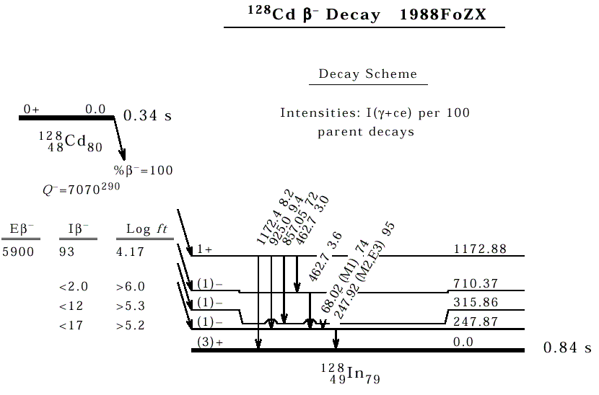
Example
β ⁻ :
β ⁺ :
EC :
neutron
proton
The energy balance expressed in mass excess:
ΔM = M(in u) – A in keV
Q_{β} - = ΔM(A,Z) - ΔM(A, Z+1) in keV
Q_{EC} = ΔM(A,Z) - ΔM(A, Z-1) in keV
Q_{β} + = Q_{EC} – 2m_{e} in keV
3

Slide 4
Classification β decay Transitions
I_{i}π_{i}
Ε_{β}
I_{f}π_{f}
L_{b} = n defines the degree of forbiddenness (n)
allowed
forbidden
when L_{β}=n=0 and π_{i}π_{f}=+1
when the angular momentum conservation requires that L_{β}=n >0 and/or π_{i}π_{f}=-1
Fermi & Gamow-Teller

Slide 5
The Isospin Formalism
Charge independance of nuclear interaction → isobaric spin T and T_{Z} Corresponding states of Nuclei with the same mass number, differing only in T_{Z} form an isobaric multiplet. → Isobaric Multiplet Mass Equation Wigner 1957
T = 8
T_{Z} =8
β⁻
β⁺
T = 9
T_{Z} =9
Fermi, forbidden for N > Z
Only change the third component of isospin:
Only one state: ΔT=0 ; ΔI=0 ; p_{f} = p_{i}
τ Fermi
Isospin operator
στ Gamow-Teller
Can change the spin and the isospin:
Many possible final states :
ΔT=0±1; ΔI=0±1 ; p_{f} = p_{i}
Spin-Isospin operator
IMME : M = a + bTz + cTz² + (dTz³ + ….)

Slide 6
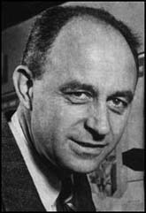

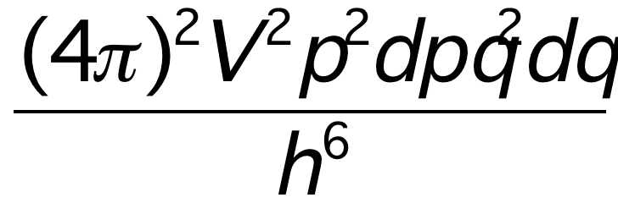
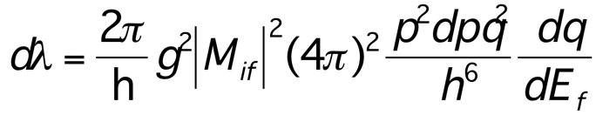
Beta-decay Formalism
Fermi gold rule
Density of final states
| i > ---> | f >
p = 2π/h | M_{if} |² dn /dE
Transition probability
M_{if} = ∫φ_{f} Η φ_{i} dv ; where H?
Energy conservation
φ_{f} = φ_{e} φ_{n} φ _{daughter}
dn = dn_{e} . dn_{ν} =
Radioactive decay constant: λ = ₀∫^{Po} p dp
Fermi function
For a allowed β transition
λ t = Log2 = Cte |M_{if}|² f (Z, E_{β}) t
Radioactive constant
t partial half-life
f (Z, E_{β}) t = Cte / | M_{if} |²
For allowed transitions

Slide 7
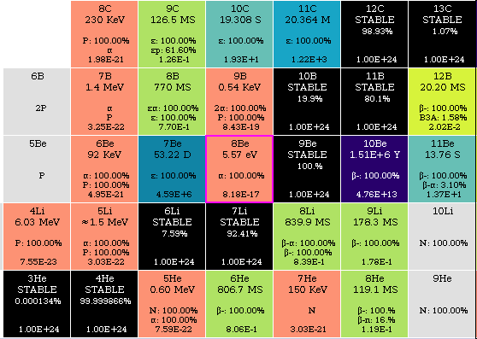
Study of the 2⁺ doublet in ⁸Be
Amazing differences in half life between the stable ⁹Be( T > 10²⁴ s) to the resonant ⁸Be (T= 9x0⁻¹⁷s).
Excited states can be study by reactions or beta-decay.
Beta-decay exclusive I^{π} reach
β-decay probes both spin,isopin
Parent?➔ ⁸Li (β⁻) & ⁸B(β⁺/EC) MIRROR NUCLEI
E(level) 8Be | I , π, Τ | Γ | Decay mode
0.0 keV | 0, + , 0 | 5.57 eV 25 | α (100%)
3010(10) keV | 2, +, 0 | 1513 keV 15 | α (100%)
11350 (15) keV | 4, +, 0 | 3500 keV | α (100%)
16626 (3) keV | 2,+, 0/1 | 108.1 keV 5 | α (100%)
16922 (3) keV | 2, +, 0/1 | 74.0 keV 4 | α (100%)
17640 (1) keV | 1, +, 1 | 138 keV 6 | p (99.8%) + IT = 0.204
ΔM(⁸Li) = 20.945 keV
ΔM(⁸B) = 22.921,5 keV
ΔM(⁸Be) = 4.941,6 keV
Q_{β-} = 16003,4 keV
Q_{ΕC}= 17979,9 keV

Slide 8

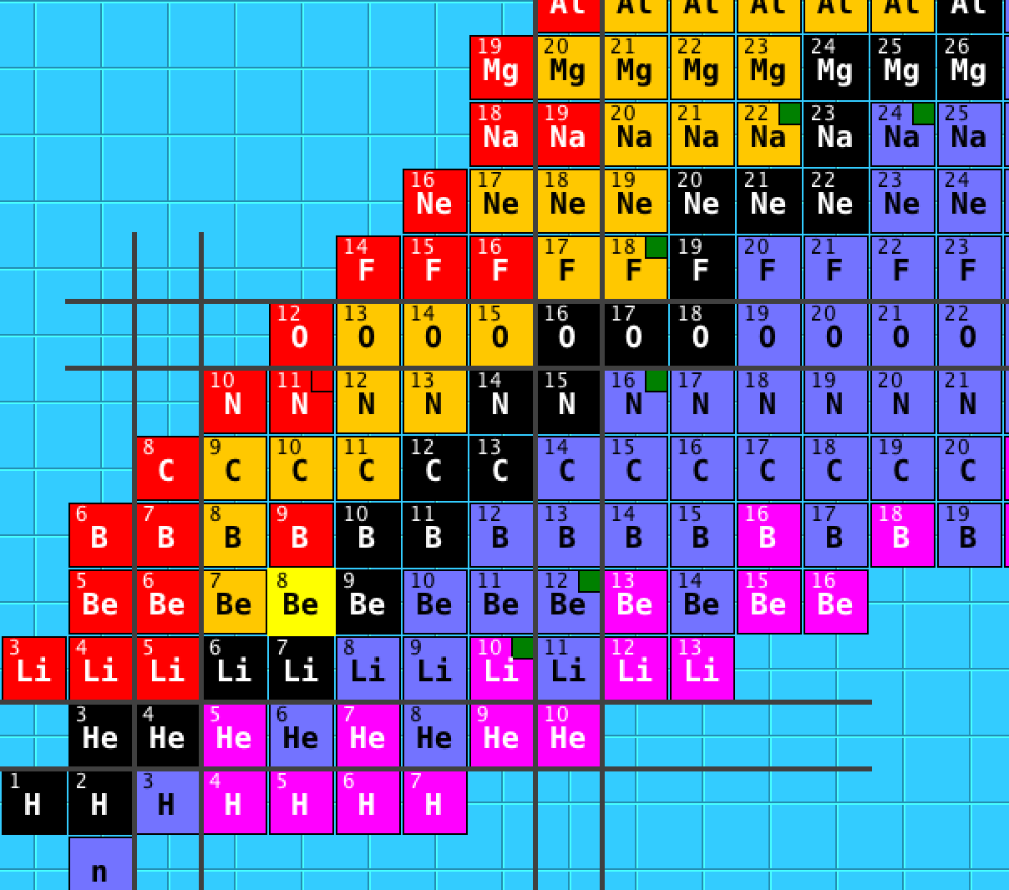
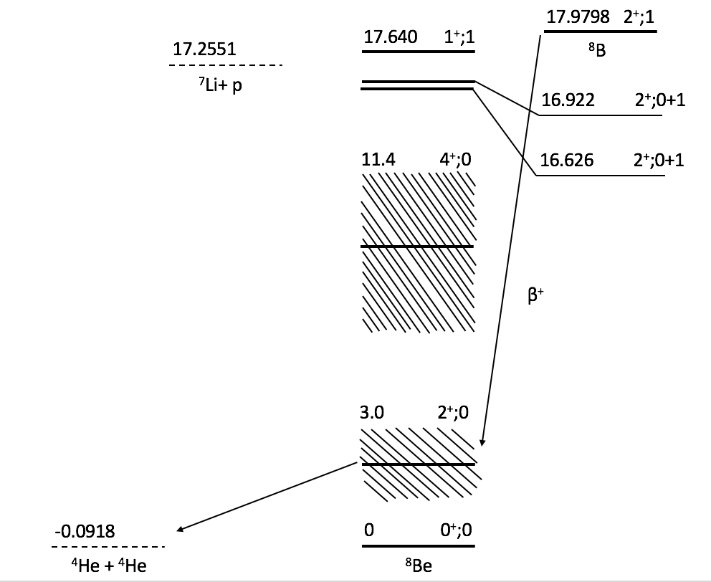
Case of Interest: the ⁸B decay
proton halo in its ground state
T. Nilsson et al., Hyperfine Int. 129 (2000) 67
source of solar neutrinos above 2 MeV
⁸B is the unique
Mainly β⁺ to 3.03 MeV state (core)
2α break up
⁸B
⁸Li
Tilley et al., NPA 745 (2004) 155
8

Slide 9
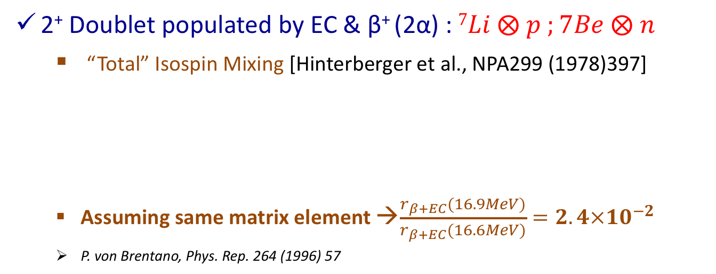
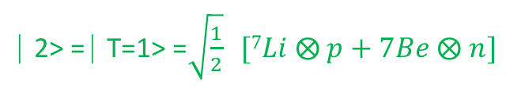
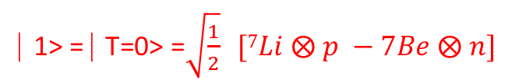
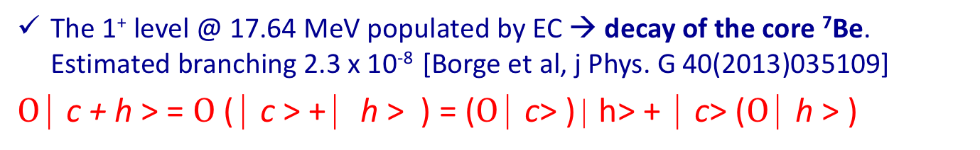

Why are these states interesting?
2⁺ Doublet populated by EC & β⁺ (2α) : $7Li ⨂ p ;7Be ⨂ n$
  “Total” Isospin Mixing [Hinterberger et al., NPA299 (1978)397]
  Assuming same matrix element →$\frac{r_{β+EC}(16.9MeV)}{r_{β+EC}(16.6MeV)}=2.4×{10}^{−2}$
  P. von Brentano, Phys. Rep. 264 (1996) 57
⎸1> = ⎸T=0> =$\sqrt{\frac{1}{2}} [7Li ⨂ p −7Be ⨂ n]$
⎸2> = ⎸T=1> =$\sqrt{\frac{1}{2}} [7Li ⨂ p+7Be ⨂ n]$
The 1⁺ level @ 17.64 MeV populated by EC → decay of the core ⁷Be. Estimated branching 2.3 x 10⁻⁸ [Borge et al, j Phys. G 40(2013)035109]
$Ο$ ⎸c + h > = $Ο$ ( ⎸c > + ⎸ h > ) = ($Ο$ ⎸c> ) ⎸h> + ⎸c> ($Ο$ ⎸h > )
Nilsson Hyperfine Int. 129 (2000) 67
Notes:
Detailed investigation of the two 2+ resonances in 8Be was done by Hinterberger who studied the excitation function of elastic alpha-alpha scattering in small energy steps at the bonn cyclotron.
The two unbound 2+ states have the dominant configuration 7li+p and 7Be+n.
From charge symmetry one expects that the unperturbed states have nearly degenerate enegies
The only open channel is alpha, so it is a 2 level, 1 channel problem and the decay will only happen via the T== componente of the two states therefore the isospin basis is a better representation of the system.

Slide 10
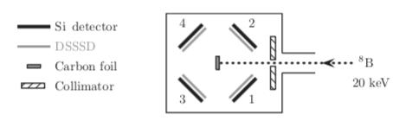
Previous Studies
Measurement at IGISOL (Finland) in 2008
1. α-emission for ⁸B neutrino spectrum
O. Kirsebom et al., Phys. Rev. C 83 (2011) 065802
Activity in the chamber: 200 Bq
Spectra at low energies → possible hint of proton branch ?
5 events at 16.9 MeV state → 1st hint
180 counts in 16.6 MeV peak
5 / 180 = 3 x 10⁻²
Limit of the branch 2.6 x 10⁻⁵ (2σ)

Slide 11
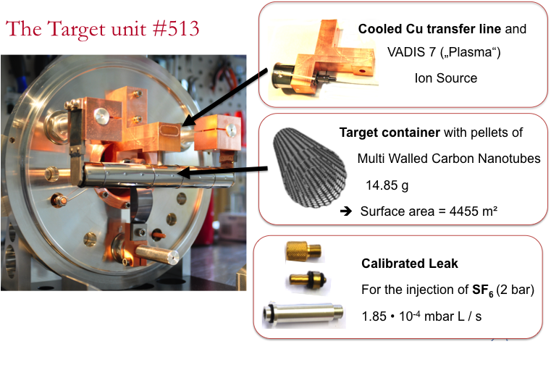
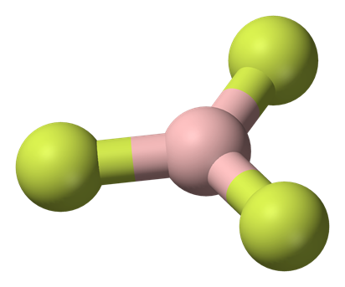
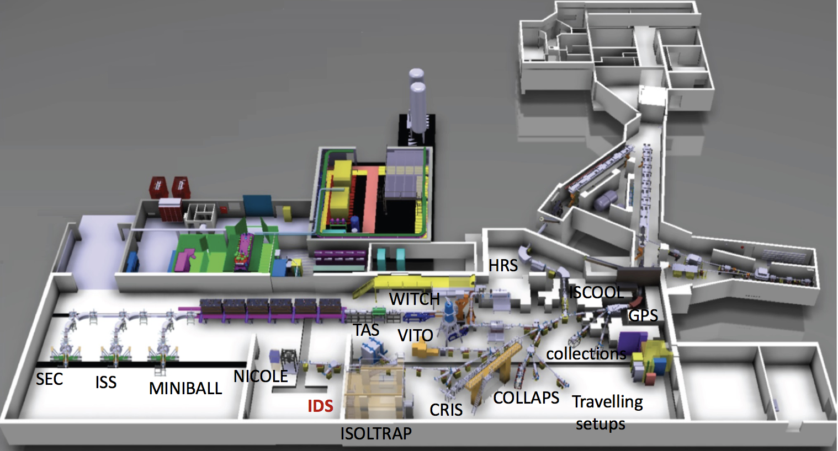

⁸B production
SF₆ (g)
⁸B
⁸BF₂⁺ (g)
⁸BF₂
Activity in the chamber: 6000 Bq, Factor 30

Slide 12
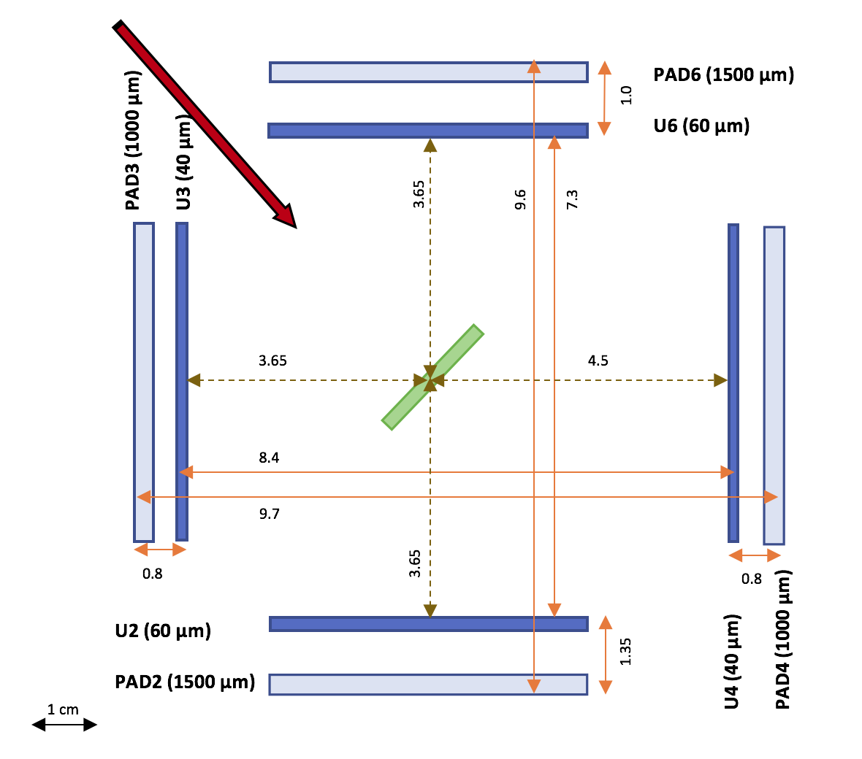
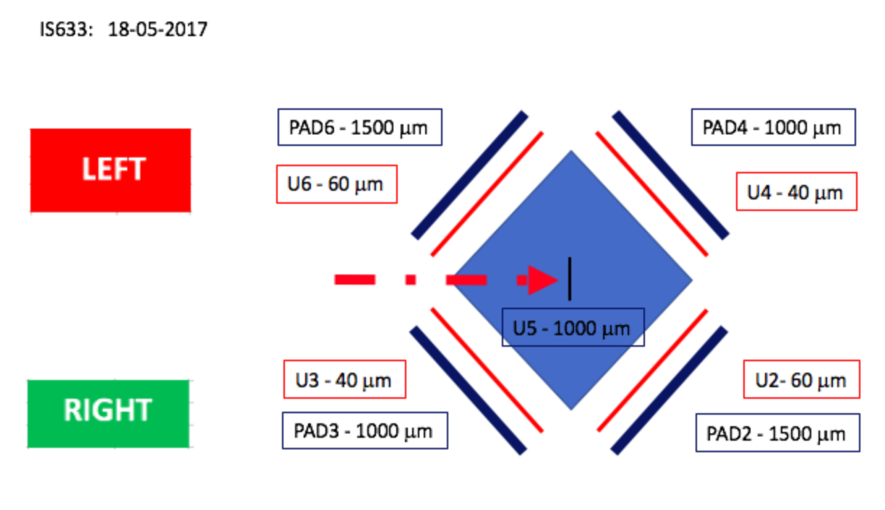

Experimental Setup
⁸B
4 Si △E-E telescopes DSSD + PAD
Coin 60μm -- 60μm (U6 & U2)
  (stop α: 1-10 MeV
  --- 40μm -- 40μm (U3 & U4)
      (low β-response)
α
β
α
$$Ω=38\% 4π$$

Slide 13
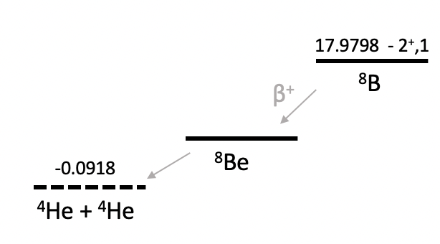


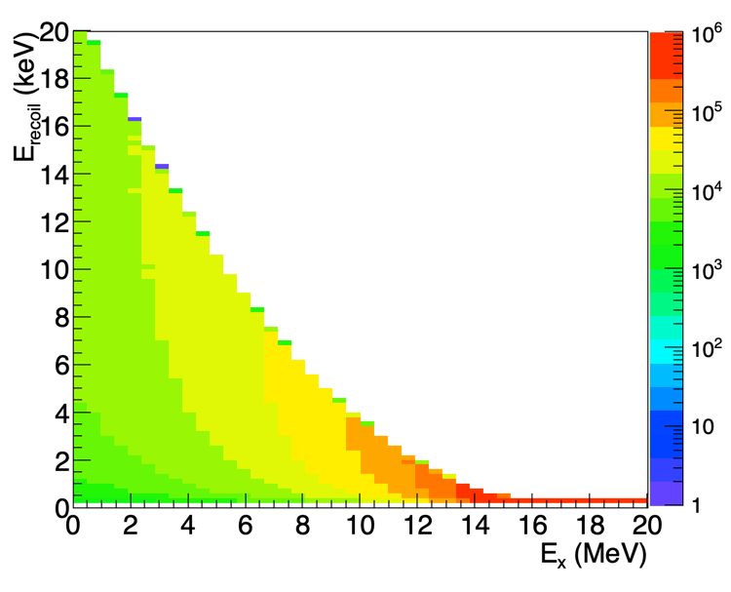
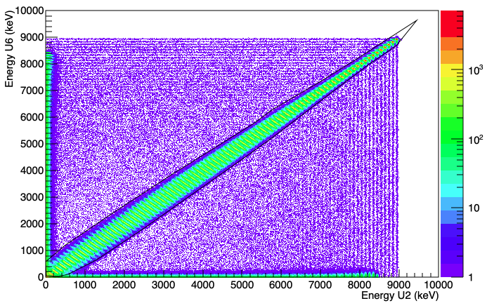
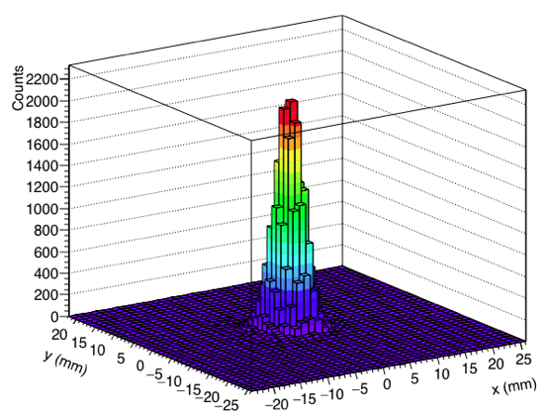
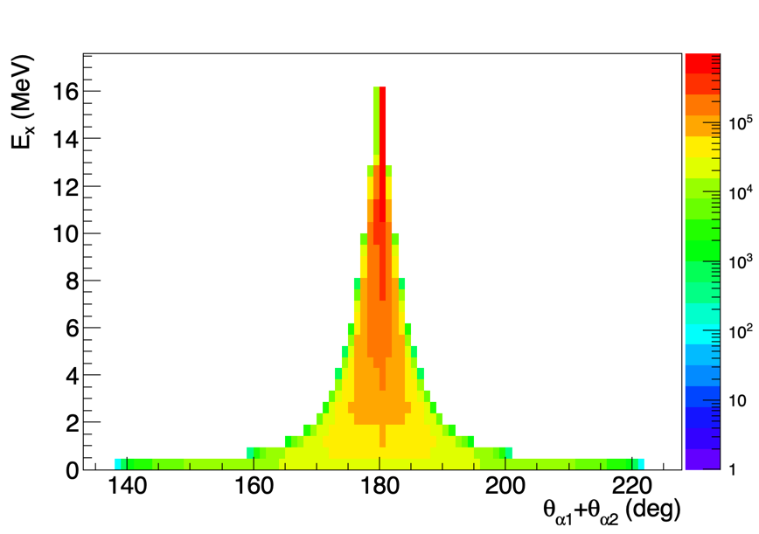
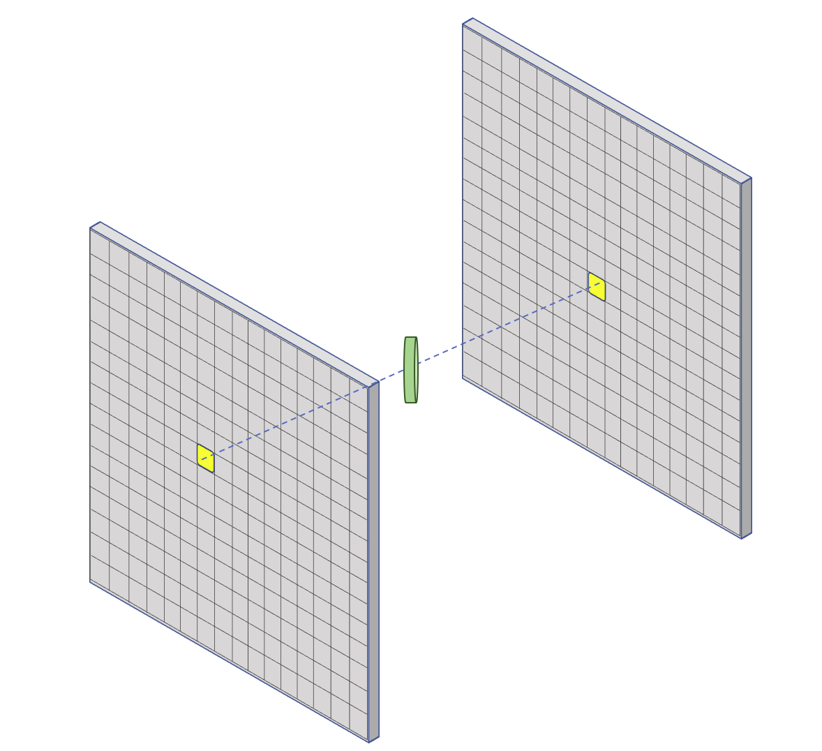
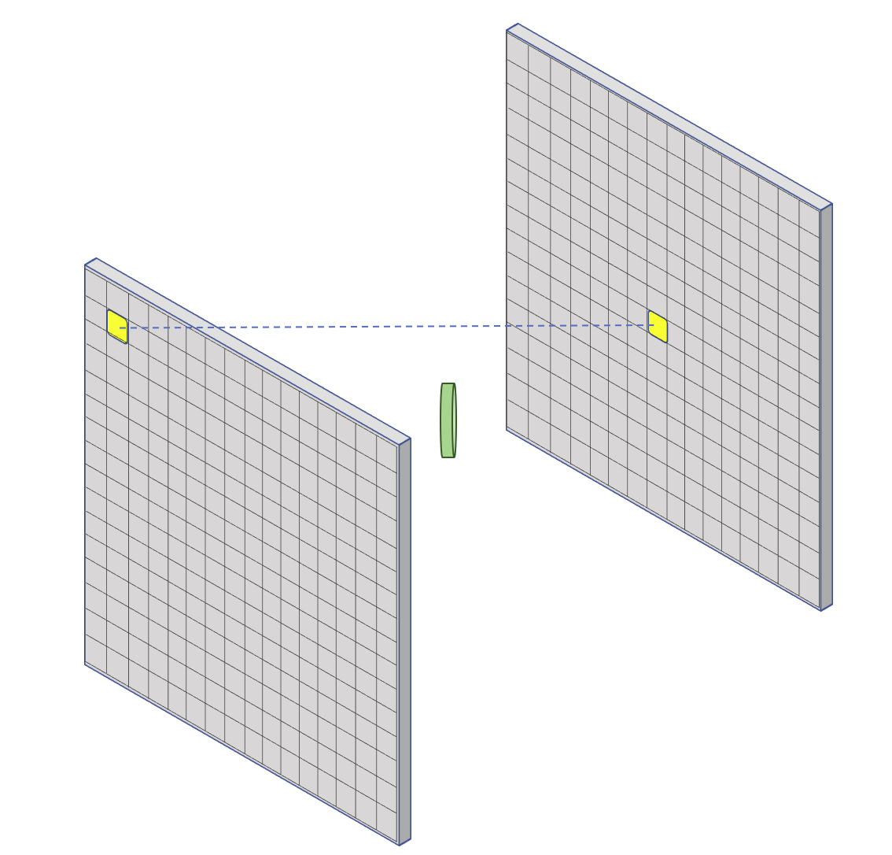


α-α tracking
Kinematic
Recoil E =20.000- 100 eV
Energetic
α - α detection must be at 180(5)º
EXP
E_{α1} and E_{α2} should be equal
Reconstruction of the emission point
Beam Spot
△x = 4.02(6) mm
△y = 3.70(6) mm
11/12/2020
11/12/2020

Slide 14
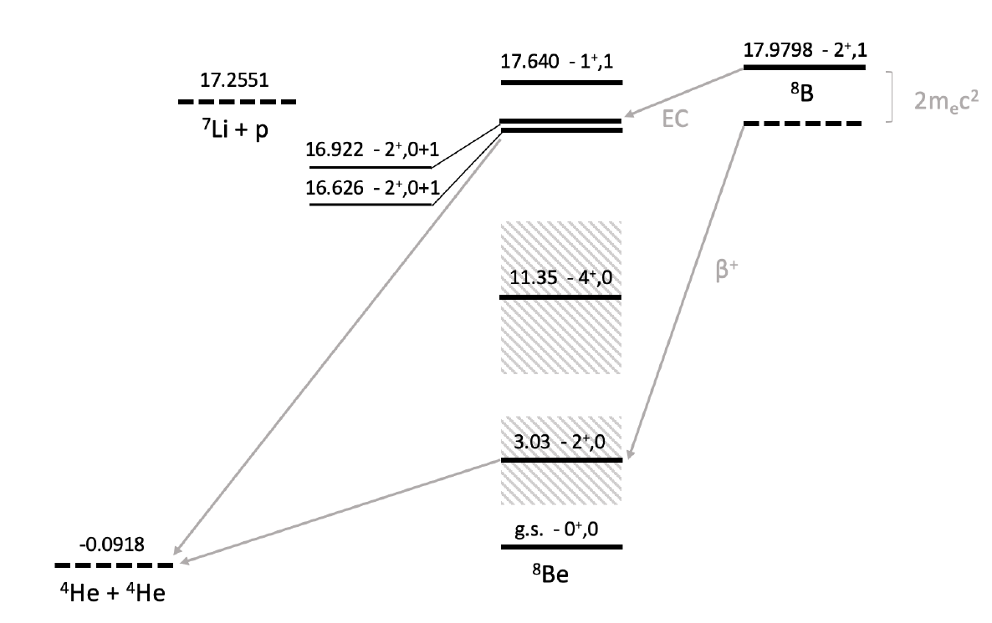

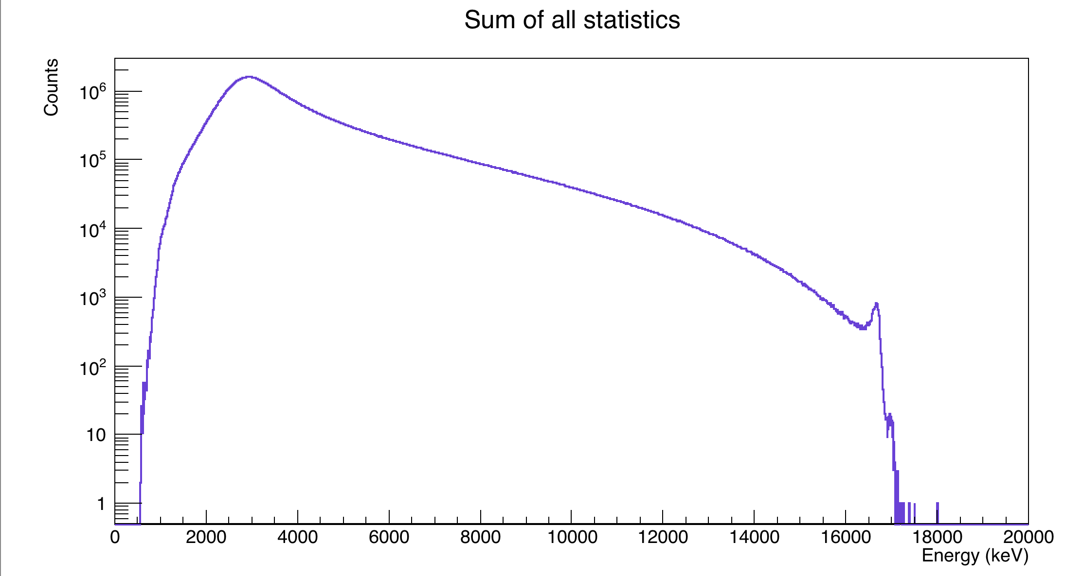
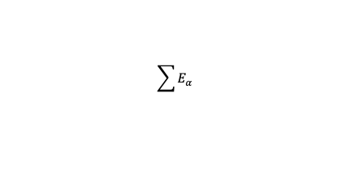
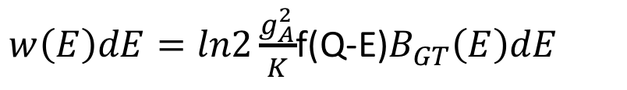
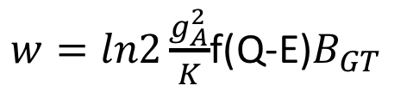
Beta decay summary
Experimental Spectrum
Narrow levels
$w=ln2\frac{g_{A}^{2}}{K}$f(Q-E)$B_{GT}$
Broad levels
$w\left(E\right)dE=ln2\frac{g_{A}^{2}}{K}$f(Q-E)$B_{GT}\left(E\right)dE$
$$\sum{E_{α}}$$
How do ones get the feeding to each level?
Eexc (⁸Be) = 2Eα – 0.0918 MeV

Slide 15
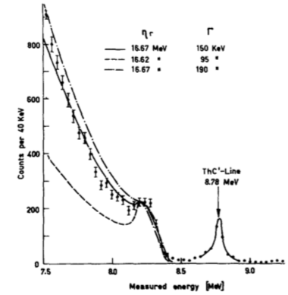
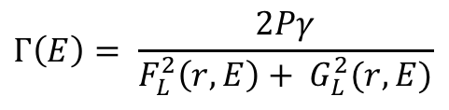
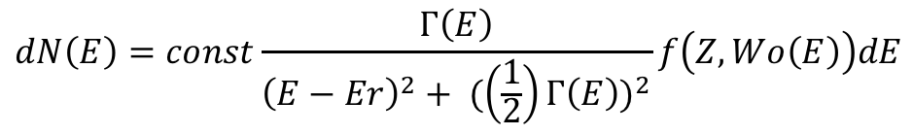
R-Matrix Analysis
R-matrix formalism developed to resolve nuclear resonances in reactions studies
Barker proposed to Matt [PL9(1964)17] to interpret the ⁸B decay using the formalism developed for reactions when β-decay involves broad levels. As neither the width not the “f” is constant along the level , rather they are energy dependent [F.C. Barker, Aus. Journ. Phys. 22 (1969) 293].
The method assumes two regions: internally only nuclear potential, outside only Coulomb interaction. Border is the channel radius = Rc = a(A₁ ^{1/3} + A₂ ^{1/3} ); a = 1.35 fm
A.M. Lane and R.G. Thomas., Rev. Mod. Phys. 30 (1958) 257
$$dN\left(E\right)=const\frac{Γ\left(E\right)}{{\left(E−Er\right)}^{2}+ {(\left(\frac{1}{2}\right)Γ\left(E\right))}^{2}}f\left(Z,Wo\left(E\right)\right)dE$$
Matt , PL9(1964)17
Wo (E ) = Q_{EC}- E
16.6 MeV
$$Γ\left(E\right)= \frac{2Pγ}{F_{L}^{2}\left(r,E\right)+ G_{L}^{2}(r,E)}$$
Notes:
The R-matrix theory was formulated to resolve the nuclear resonances in reaction experiments, following the calculation of the cross section of the involved resonances. Later in 1969, Barker adapted the theory to -decay followed by two body break-up of the daughter nucleus.
It is based on considering the nuclear interaction in two regions. On one hand, the internal region where only is present the nuclear potential. On the other hand, the external region, which is purely Coulomb interaction. The border between the two regions is the channel radius

Slide 16
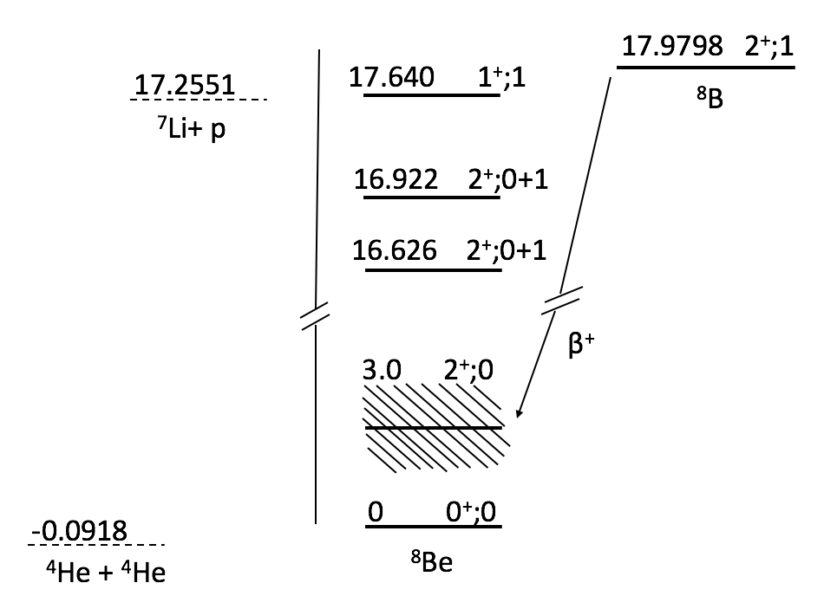
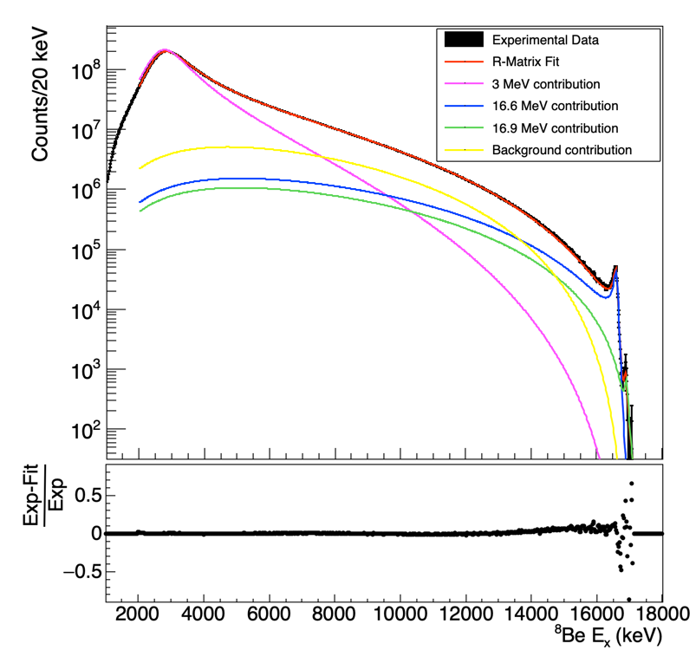
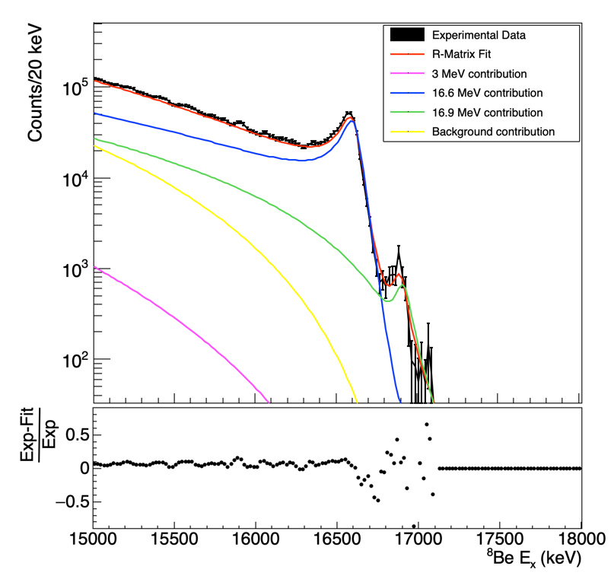
R-Matrix analysis of ⁸B decay
Ingredients: Unfolded spectrum (β-feeding) + unitary response matrix
No influence of the 3 MeV state in the doublet !!
Good fit of the región of interest and of the full spectrum

Slide 17
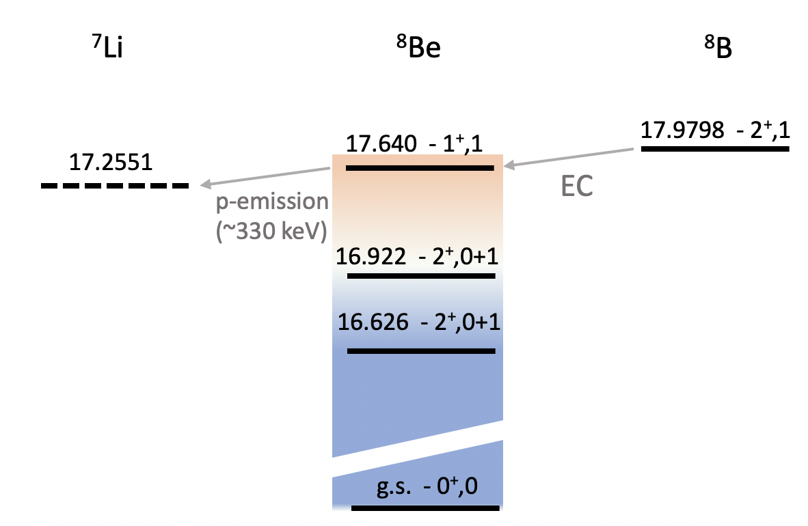
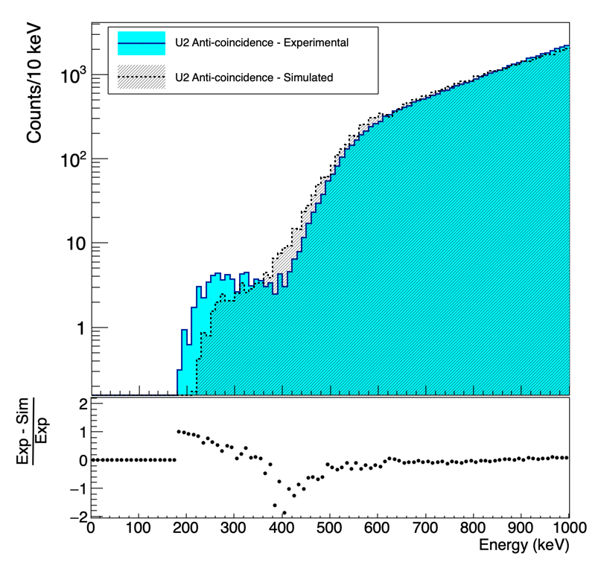
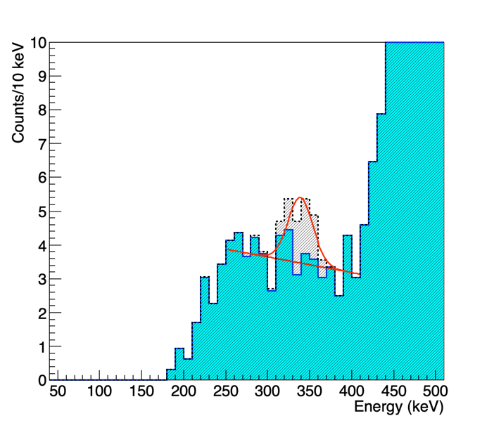
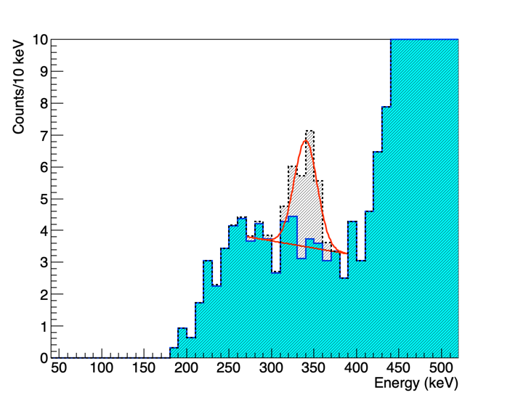


Feeding 17.6 MeV state? EC-p branch
EC
⁸B
$$∆E=385keV→E_{p}\sim ∆E·\frac{7}{8}keV$$
ROI→ $E_{p}±FWHM$ = $\left(330±20\right)keV$
The threshold of each detector was carefully scrutinised
Only one had enough sensitibity at very low energy
BR < 2.5·10⁻⁶ (3σ)
BR < 4·10⁻⁶ (5.7σ)
Previous limit of the branch 2.6 x 10⁻⁵ (2σ)

Slide 18
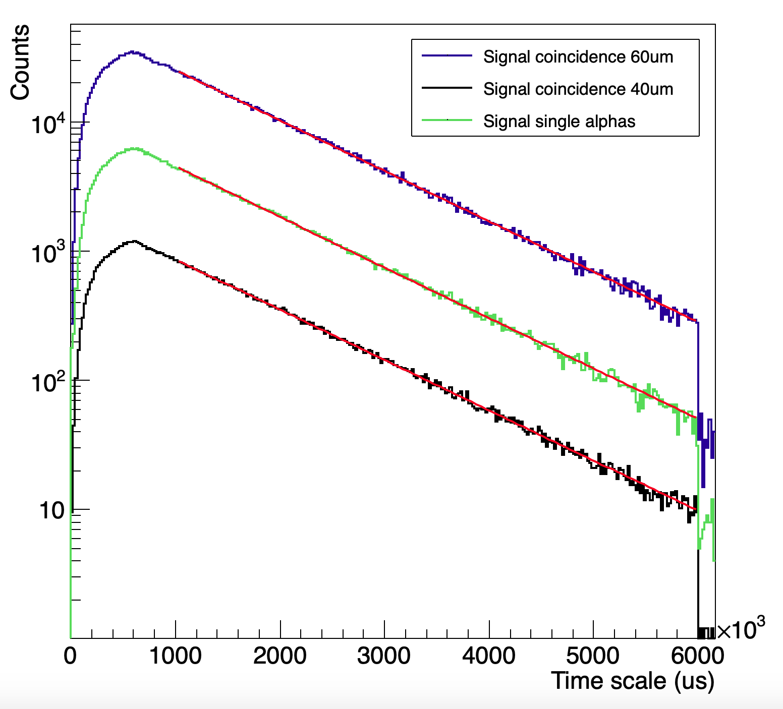
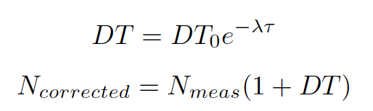
Half-life and Dead-Time correction
T_{1/2}= 770(3) ms
Previous Value
Three independent measures
Energy range to ensure only α-α
F. Ajzenberg-Selove et al., Nuc. Phys. A 277 (1974) 1-243, 1
Dead-time correction
x5
T_{1/2 exp}= 772(1) ms
Weighted Average Half-life
T_{1/2}= 771.9(9) ms
x0.2
Uncertainty reduced by 3.3
S. Viñals et al., Acta Phys. Polon. B 51 (2020):717-723,

Slide 19
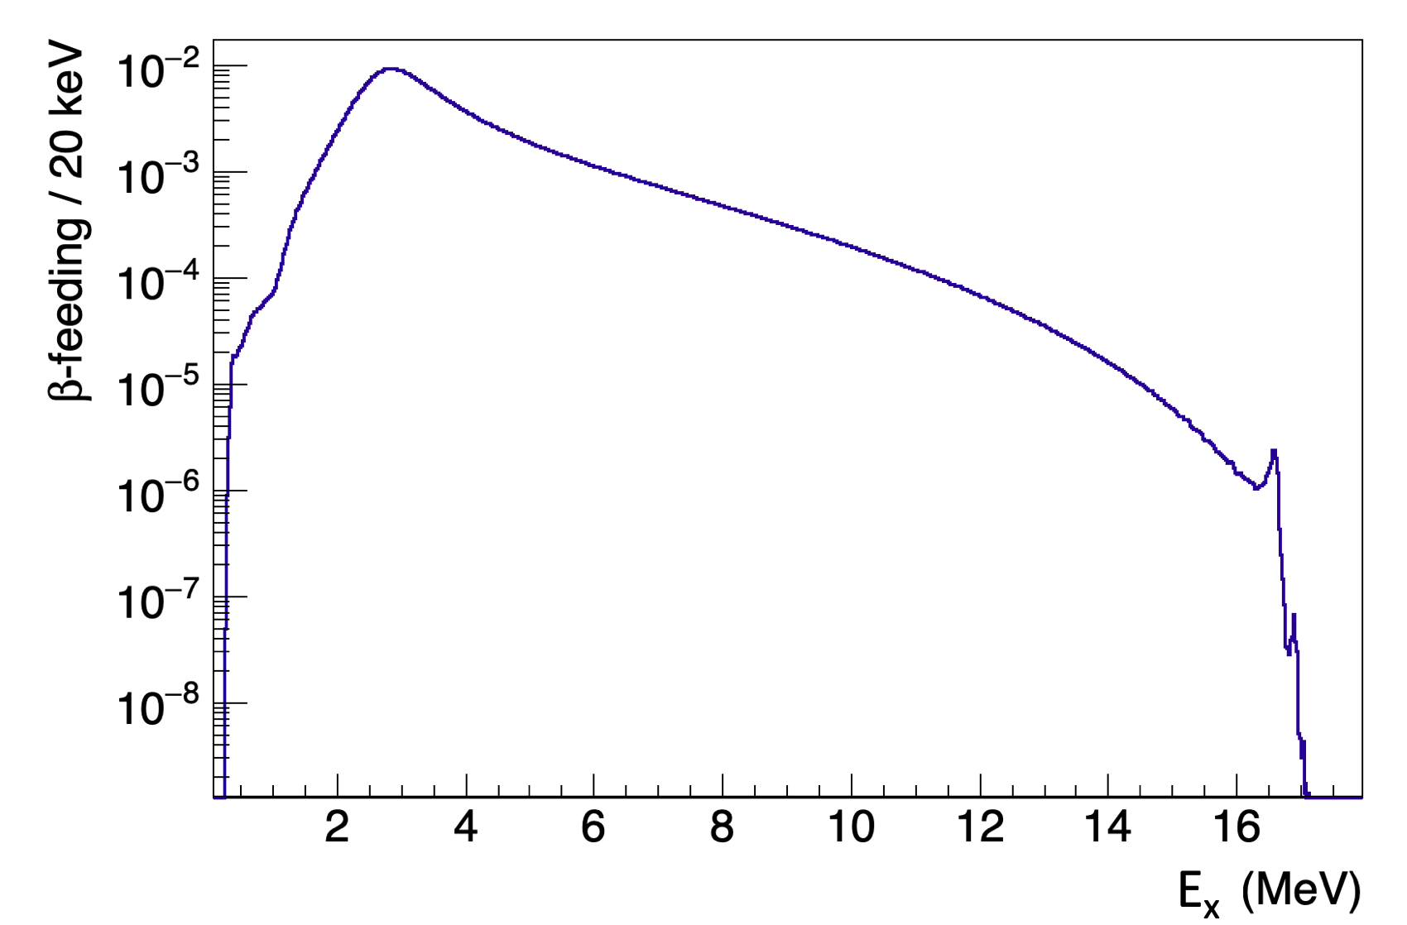
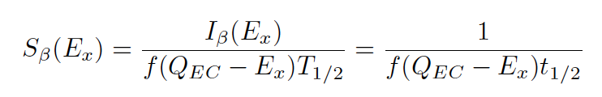
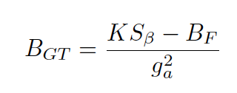
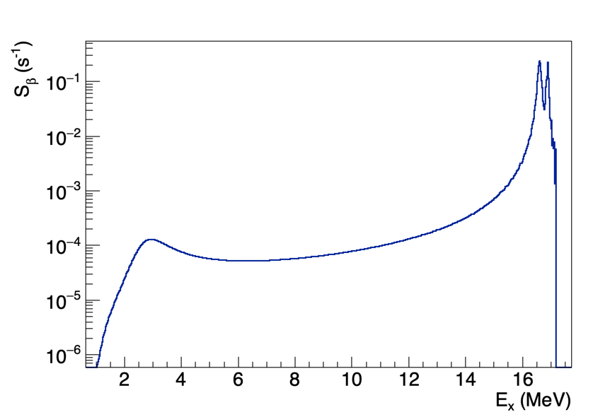
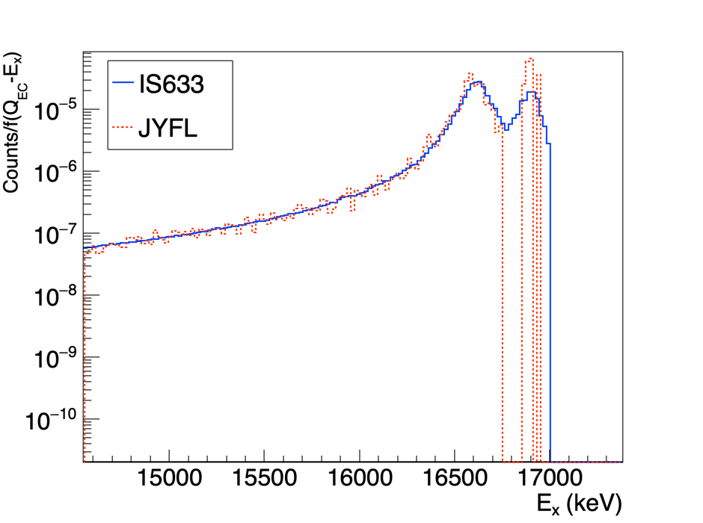
⁸Β β-Strength
I_{β}

Slide 20
Summary
We have studied the β⁺-EC decay of ⁸B at ISOLDE with the aim to measure for the first time both the feeding to the 2⁺ state at 16.6 MeV and to the 16.9 MeV state
The 2⁺ doublet states has been observed with significant statistics to extract the feeding by R-matrix analysis.
Obtained the isospin mixing parameters α and β defining the mixing of the 2+ doublet.
The half-life of ⁸B has been improved with a factor of 3 less uncertainty. The new averaged value is T_{1/2} = 771.9(9) ms.
An experimental upper limit for the rare EC-p-branch obtained,still far from the expected value around 10⁻⁸

Slide 21
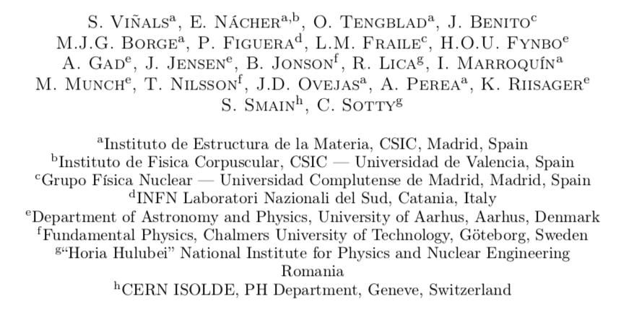

S. Viñals i Onsès^{(1,5)} , for the MAGISOL Colaboration^{(1,2,3,4)}
(1) Instituto de Estructura de la Materia, CSIC, Serrano 113bis, E-28006 Madrid, Spain
(2) Department of Physics, University of Aarhus, DK-8000, Aarhus, Denmark
(3) Fundamental Physics, Chalmers University of Technology, S-41296, Göteborg, Sweden
(4) CERN ISOLDE, PH Department, CH1211, Geneve 23, Switzerland
(5) Centro de Micro-análisis de Materiales, UAM, Faraday 3, Madrid, Spain
Thank you for your attention
S. Viñals i Onsès^{(1,5)} , for the MAGISOL Colaboration^{(1,2,3,4)}
(1) Instituto de Estructura de la Materia, CSIC, Serrano 113bis, E-28006 Madrid, Spain
(2) Department of Physics, University of Aarhus, DK-8000, Aarhus, Denmark
(3) Fundamental Physics, Chalmers University of Technology, S-41296, Göteborg, Sweden
(4) CERN ISOLDE, PH Department, CH1211, Geneve 23, Switzerland
(5) Centro de Micro-análisis de Materiales, UAM, Faraday 3, Madrid, Spain
S. Viñals i Onsès^{(1,5)} , for the MAGISOL Colaboration^{(1,2,3,4)}
(1) Instituto de Estructura de la Materia, CSIC, Serrano 113bis, E-28006 Madrid, Spain
(2) Department of Physics, University of Aarhus, DK-8000, Aarhus, Denmark
(3) Fundamental Physics, Chalmers University of Technology, S-41296, Göteborg, Sweden
(4) CERN ISOLDE, PH Department, CH1211, Geneve 23, Switzerland
(5) Centro de Micro-análisis de Materiales, UAM, Faraday 3, Madrid, Spain
Silvia Viñals, Ph D Defense on the December 11th, 2020

