Slide 1
Continuing Influence of Shell Effects in the Nuclear
Quasi-Continuum
⁴⁵Sc
Cebo Ngwetsheni
Nico orce
⁵¹V
¹⁵³Sm
⁵⁰V
⁵⁶Fe

Slide 2
Outline
Nuclear Polarizability​
Low energy enhancement (LEE)​
Systematics & Results​
Conclusion & Work Ahead

Slide 3
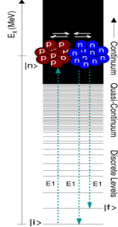
Nuclear Polarizability
Nuclei polarize in presence of an external electromagnetic field.
Polarizability is driven by the dynamics of the giant dipole resonance (GDR) [1].
Inter-penetration motion of proton and neutron fluids, out of phase.
The GDR motion is induced by the nuclear symmetry energy, acting as a restoring force [1].
from the Bethe-Weizsacker semi-empirical mass formula:
Ground state
Figure: 1a

Slide 4
Nuclear Polarizability
Polarizability can be described macro- and microscopically:​
Hydrodynamic model [1] ​
​
​
​
assuming a well-defined nuclear surface:
2. Second order perturbation theory [1]:
where,
Figure 1b

Slide 5
Nuclear Polarizability
Naturally, total cross section values should include both electric and magnetic polarizability contributions,
IPM: diamagnetism is dominant for nuclei with A > 60 and paramagnetism dominates in light nuclei with the rise of permanent magnetic dipole moments and can contribute substantially to σ₋₂ values for nuclei with A < 20 [2].
where the magnetic polarizability is dependent on paramagnetic and diamagnetic susceptibilities,

Slide 6
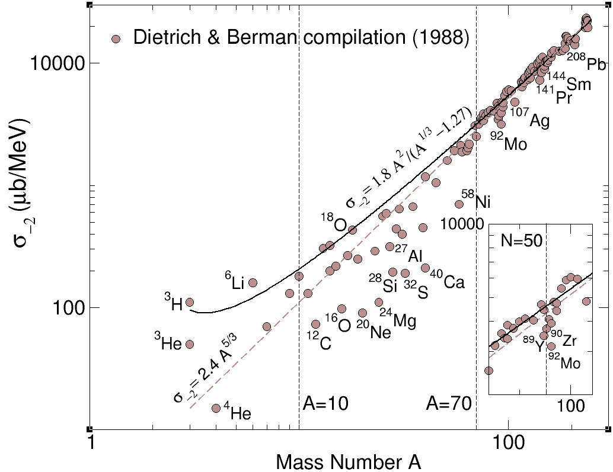
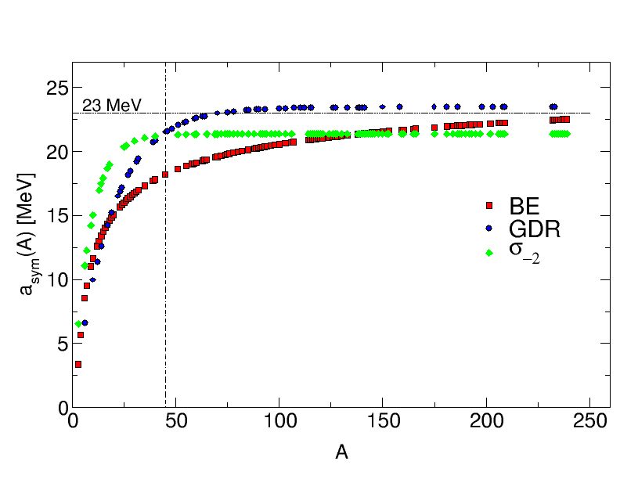
Polarizability & Symmetry Energy
Mass dependence of the symmetry energy yields [3][4] :
Figure 2

Slide 7
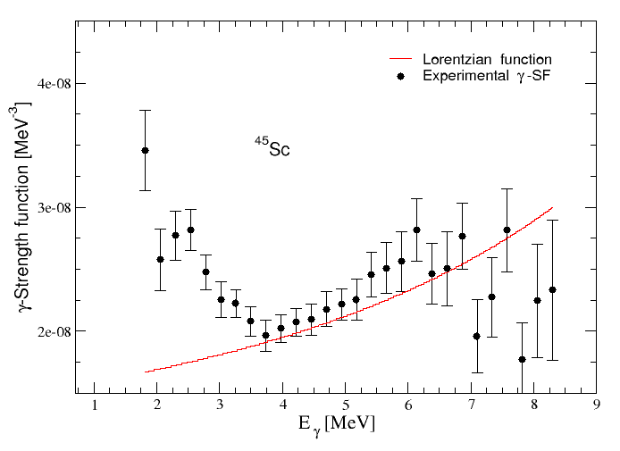
Low-Energy-Enhancement
LEE is observed as an up-bend at low energies of measured photon strength function (PSF) for medium and heavy-mass nuclei.
LEE observed in medium and heavy mass nuclei starting at ~ 3 MeV & ~ 2 MeV, respectively.
The physical origin of the LEE remains ambiguous, observed in A ≈ 50 and 90 mass region. Interpreted as:
TCQRPA, predicts E1 transitions from the hot quasi-continuum to continuum region produces the up-bend [4]​.
Shell model calculations predict LEE has a predominant M1 character, resulting from active high-j proton & neutron orbits with magnetic moments adding up coherently [5]. ​
Figure 3

Slide 8
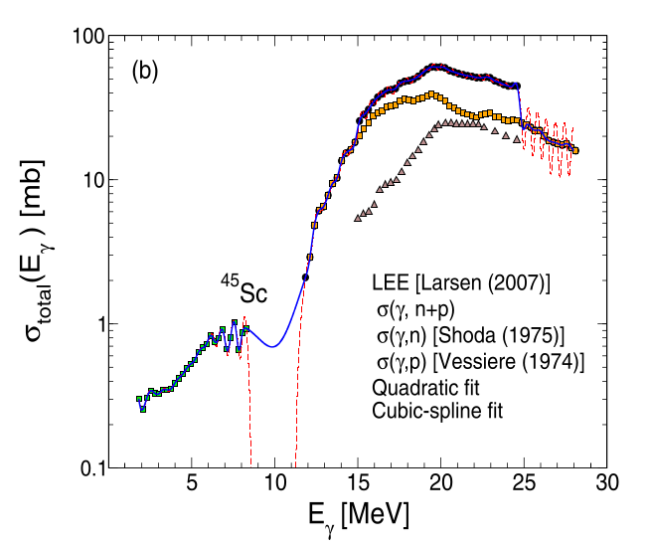
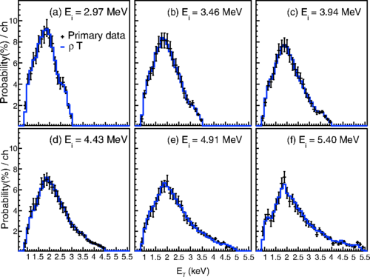
LEE & GDR
The similar features suggest a common physical origin for all GDR's in concordance with the Brink-Axel hypothesis, which also posits that a GDR can be built on every state in a nucleus.
In order to combine the cross-section contributions from the LEE and GDR , we use the relation:
Henceforth, we assume similar resonance strengths for GDR s built on the ground and excited states.
where,
²³⁸Np

Slide 9
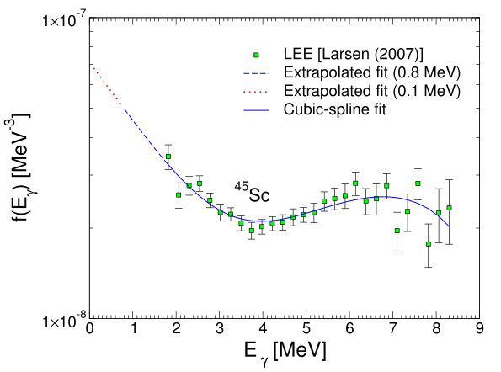
LEE Extrapolation
Setting up the low-energy cut off is not obvious.
Recent SM calculations support the continuaation of the LEE to 0 MeV.
We investigated two cases; extrapolation down to 0.8 MeV and 0.1 MeV

Slide 10
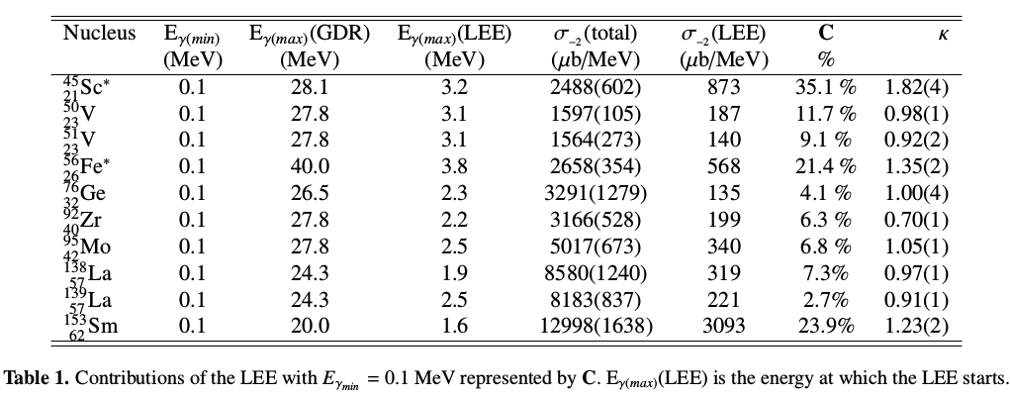
The semi-magic nuclei present smaller polarizability parameters, less than unity.
The polarizability accunts for deviations from actual GDR effects to that predicted by the hydrodynamic model
These observations support continuation of shell effects in the quasi-continuum region where LEE occurs

Slide 11
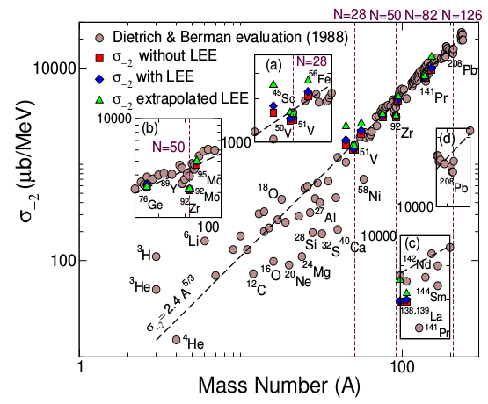

Slide 12
CONCLUSION
The sudden σ₋₂ values and k<1 for nuclei with neutron magic numbers N = 28, 50 and 82 supports the M1 nature of the LEE predicted by SM calculations.
And validity of the Brink-Axel hypothesis, which seems to allow for structural changes.
This work emphasizes the need for additional f(Eγ) measurements at low energies below 1 MeV and photo-proton cross sections, particularly for low mass nuclei.

Slide 13
Other Work ...
Implications of κ:
κ > 1 may strongly affect the determination of reduced transition probabilities, or B(E2)'s and Qs values.
κ < 1 indicates shell effects.
The polarization potential, proportional to α, tends to reduce the effective quadrupole potential,
,
to be corrected !!

Slide 14
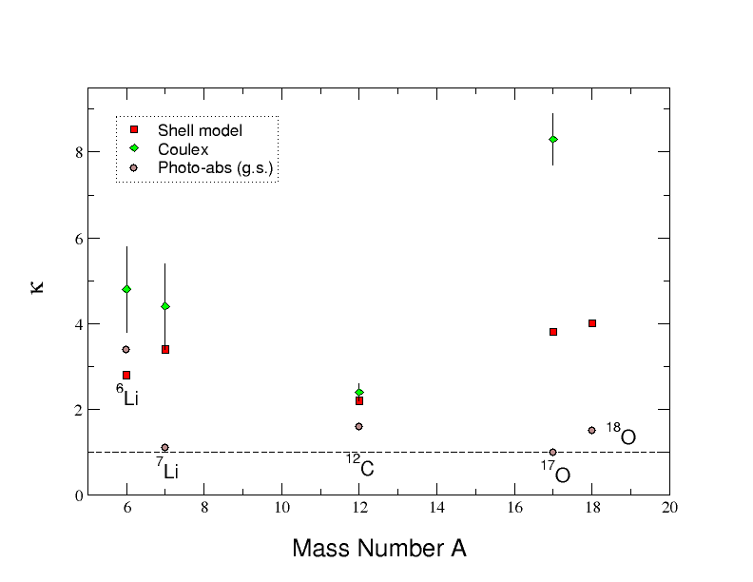
Other Work ...
Only three favorable Coulomb-excitation measurements provide unambiguous information on κ values of excited states; namely ⁶Li (J=3) , ⁷Li (J=½), 17O (J=½) shown as green diamonds
NB: Q_{s} = 0 for J=0, ½ allowing reliable measurements of κ values.
Shell model κ values are represented by red squares in the Figure.
Nucleus | E_{x} (MeV) | J^{π} | κ_{SM} | κ_{Coulex}
⁷Li | 0.478 | ½⁻ | 3.4 | 4.4 (10)
¹²C | 4.439 | 2₁⁺ | 2.2 (2) | 2.2+0.2
¹⁷O | 0.871 | ½⁺ | 3.8 | 8.3 (6)
Figure 3

Slide 15
Thank You !!

